Slide 1


// Reduced Inequalities // Teaching Learning Unit
How can we reduce global inequalities post Covid-19?
SDG: 10

Slide 2
// Reduced Inequalities //
Teaching Learning Unit
DURATION
1hour
LEARNING OBJECTIVES OF THIS PHASE
Students will be able to:
Develop their views on inequalities around the world
Explain what inequality is post Covid-19
Evaluate the impact of Covid-19 on national global inequality
Students can explain what inequality is and identify some current trends between and within countries post Covid-19
BIG IDEA
WHAT IS IT
Big Idea Reducing Inequalities
Reducing Inequality:
Reducing inequalities and ensuring no one is left behind are integral to achieving the Sustainable Development Goals.
Inequality within and among countries is a persistent cause for concern. Despite some positive signs toward reducing inequality in some dimensions, such as reducing relative income inequality in some countries and preferential trade status benefiting lower-income countries, inequalities still persist.
Reducing Inequality post Covid-19:
COVID-19 has deepened existing inequalities, hitting the poorest and most vulnerable communities the hardest. At the same time, social, political and economic inequalities have amplified the impacts of the pandemic. On the economic front, the COVID-19 pandemic has significantly increased global unemployment and dramatically slashed workers’ incomes. COVID-19 also puts at risk the limited progress that has been made on gender equality and women’s rights over the past decades. Inequalities are also deepening for vulnerable populations in countries with weaker health systems and those facing existing humanitarian crises. Refugees and migrants, as well as indigenous peoples, older persons, people with disabilities and children are particularly at risk of being left behind. Hate speech targeting vulnerable groups is rising.
WHAT TEACHER DOES – lesson start
The teacher introduces lesson objectives and big ideas
ACTIVITY 1: Brainstorming Equality [ 10 minutes]
First, pupils will be asked to independently write a couple of sentences about what they think equality means.
Pupils will then pair up with another pupil to share their ideas and together produce a definition that includes both perspectives on equality.
Pairs will then share their ideas to the whole class. The teacher will pick out key words from each pairs definitions and record them on the whiteboard.
Pupils will be asked to find some of the similarities and differences between each pairs views on equality to collectively produce one definition of equality – this can be written down for all pupils to see.
ACTIVITY 2: The sharing challenge [ 10 minutes]
  The teacher will have something they can share out between the pupils (eg. Sweets, counters, buttons, paperclips etc). The teacher will unequally divide this resource up between the pupils (some pupils will have none, some will have lot’s) and keep the majority of the item for themselves.
  Teacher will ask the pupils “is this fair?”
  Teacher will encourage some debate around the subject using prompts such as “well I have the most because I’m older” and “XX pupil has the least because they are XXX etc”.
  Conclude this task by asking pupils “how could this be made more fair?”

Slide 3
// Reduced Inequalities //
Teaching Learning Unit
ACTIVITY 3: Types of Inequality; National and Global [ 15 minutes]
  In small groups, pupils will be asked to create a list of different types of inequality – what characteristics or situations can lead to inequality?
  The teacher can circle the groups and ask for feedback of ideas.
  Once pupils have completed their lists they will be provided with a couple of examples to expand their thoughts
  Pupils will then be asked to think of examples of these inequalities in the UK and in globally
  The teacher will take the pupils through some national and global information around the impact of Covid-19 on inequality and provide case study examples of this from different countries.
BIG IDEA
WHAT IS IT
ACTIVITY 4: Inequality post covid-19 – raise awareness campaign [15 minutes]
Students can explain what inequality is and identify some current trends between and within countries post Covid-19
  In small groups, pupils will be asked to choose an inequality of their choice from the ones you have looked at today (e.g. gender, disability, economic etc).
  Students will do some reading/research around this inequality from the materials provided about how Covid-19 has further impacted that inequality
  Pupils will work together to plan a campaign on how to raise awareness for this particular issue. Guide’s will be provided to support pupils with this. The teacher can walk around and assist groups as well.
  Pupils will each feedback their ideas to the class
Activity 6 Reflection
[10 minutes]
The impact of Covid:
Teachers will need to give pupils time to reflect on the impact of the Pandemic on inequality both nationally and globally. Experiences will vary for each pupil so it will need to be handled very sensitively. Opportunities to discuss could be very valuable.
STEP 3
1] What kind of challenges do you expect for equality post Covid-19?
2] How can different countries Build Back Better?
3] What can you do to support equality post Covid-19?
4] Will the impact of Covid-19 on equality be greater in some parts of the world? How can we support these countries in the future?

Slide 4
// Reduced Inequalities //
Teaching Learning Unit
Pupils will complete:
Notes to adapt online for distance learning:
All of these activities can be shown digitally to pupils and they can use online platforms such as ‘Padlet’ to record their observations, work together and/or comment on each others answers and responses. Reflection can be done in small groups using online videoconferencing platforms such as ’Zoom’ / ‘Microsoft Teams’ or alternatively, by writing up their reflections and submitting to the class teacher.
Slides; 8, 9, 10, 13 and 15
Reducing Inequality
This lesson will introduce pupils to the idea of SDG 10 – Reducing Inequality post Covid-19. The main aim is to get them to start to consider their own attitudes and values on this topic, the impact this has globally and how they can Build Back Better.
Additional Resources:
All resources required for the above activities have been linked into the slides.

Slide 5

// Reduced Inequalities //
Teaching Learning Unit
How important is equality in the UK?
How will inequality be a challenge for the world post Covid-19?
STEP 3

Slide 6
// Reduced Inequalities //
Teaching Learning Unit
How can we work towards equality for all post Covid-19?
Lesson Objectives
You will be able to:
Develop your views on inequalities around the world
Explain what inequality is post Covid-19
Evaluate the impact of Covid-19 on national and global inequality
Explain what inequality is and identify some current trends between and within countries post Covid-19
STEP 3

Slide 7
// Reduced Inequalities //
Teaching Learning Unit
Big Ideas
REDUCED INEQUALITY:
Reducing inequalities and ensuring no one is left behind are integral to achieving the Sustainable Development Goals. Inequality within and among countries is a persistent cause for concern. Despite some positive signs toward reducing inequality in some dimensions, such as reducing relative income inequality in some countries and preferential trade status benefiting lower-income countries, inequalities still persist.
INEQUALITY POST COVID-19:
COVID-19 has deepened existing inequalities, hitting the poorest and most vulnerable communities the hardest. At the same time, social, political and economic inequalities have amplified the impacts of the pandemic. On the economic front, the COVID-19 pandemic has significantly increased global unemployment and dramatically slashed workers’ incomes. COVID-19 also puts at risk the limited progress that has been made on gender equality and women’s rights over the past decades. Inequalities are also deepening for vulnerable populations in countries with weaker health systems and those facing existing humanitarian crises. Refugees and migrants, as well as indigenous peoples, older persons, people with disabilities and children are particularly at risk of being left behind. Hate speech targeting vulnerable groups is rising.
STEP 3

Slide 8
// Reduced Inequalities //
Teaching Learning Unit
Activity One: Think-Pair-Share
How would you define equality?
Independently write down a couple of sentences to describe what equality means to you
In Pairs share your thoughts. Together, try and come up with a definition that includes both of your ideas
Share your thoughts with the class
STEP 3
Can you all agree on one definition of equality?

Slide 9

// Reduced Inequalities //
Teaching Learning Unit
Activity 2 – How will the cake be shared?
Do we all deserve the same?
Who will get the biggest slice?
Who deserves the smallest slice?
Who will get the smallest slice?
STEP 3
Who deserves the biggest slice?
Who doesn’t deserve any?
How can we make this fairer?
Notes:
Photo’s taken from Pexels

Slide 10
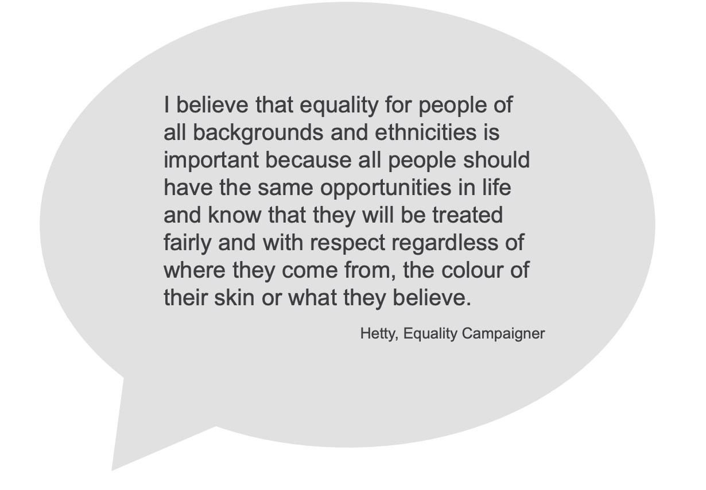
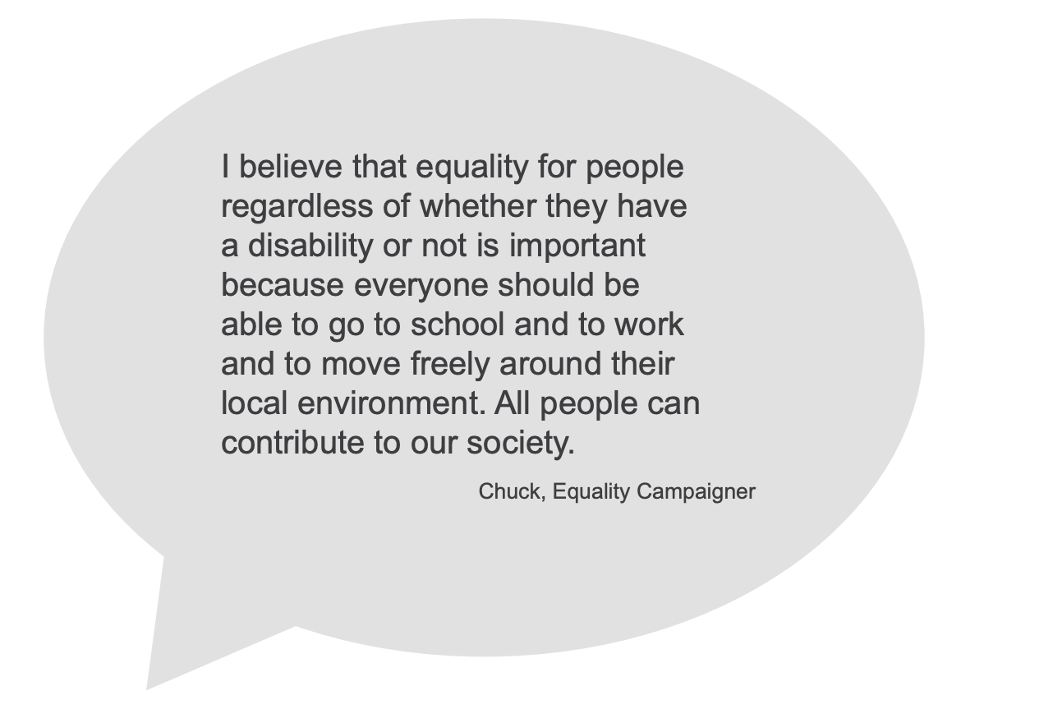
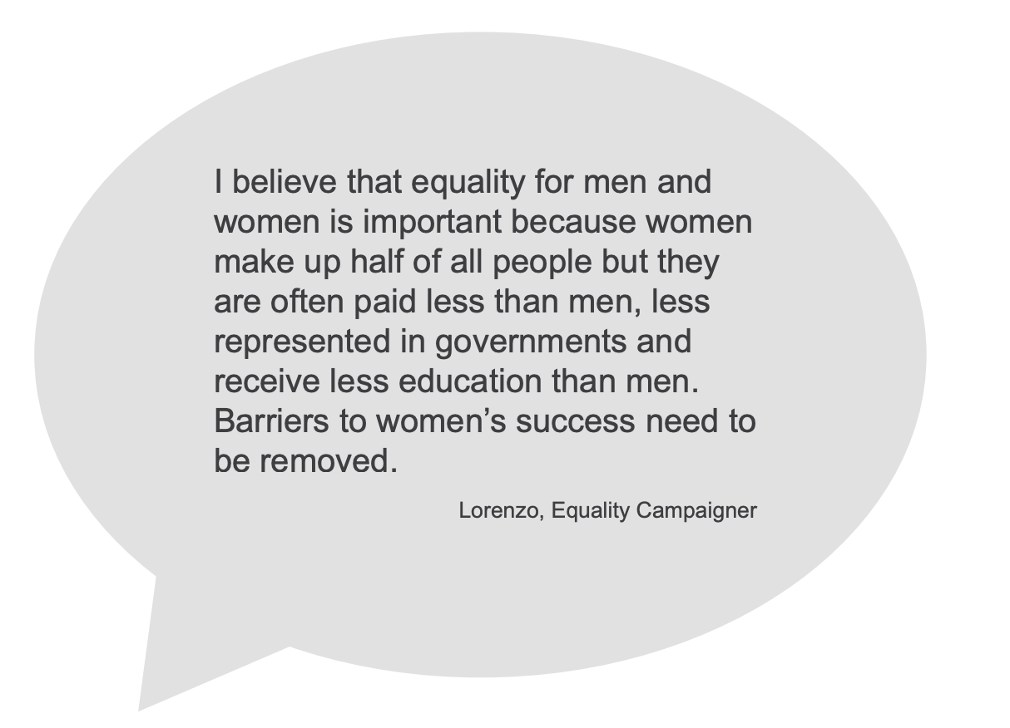
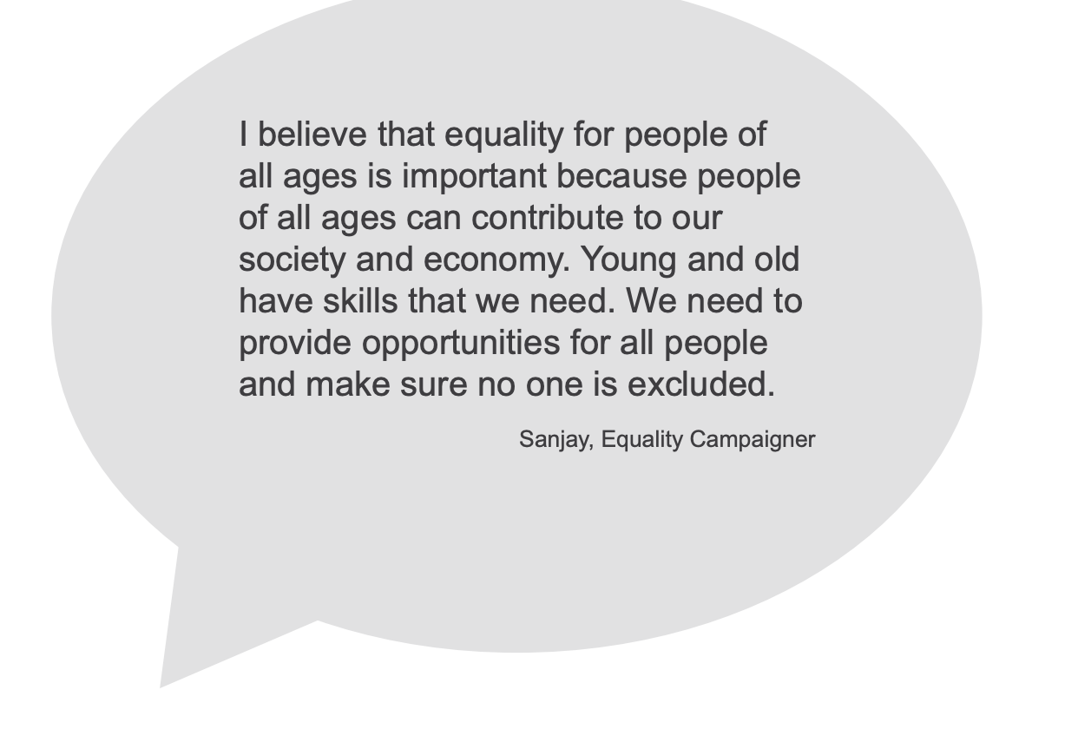
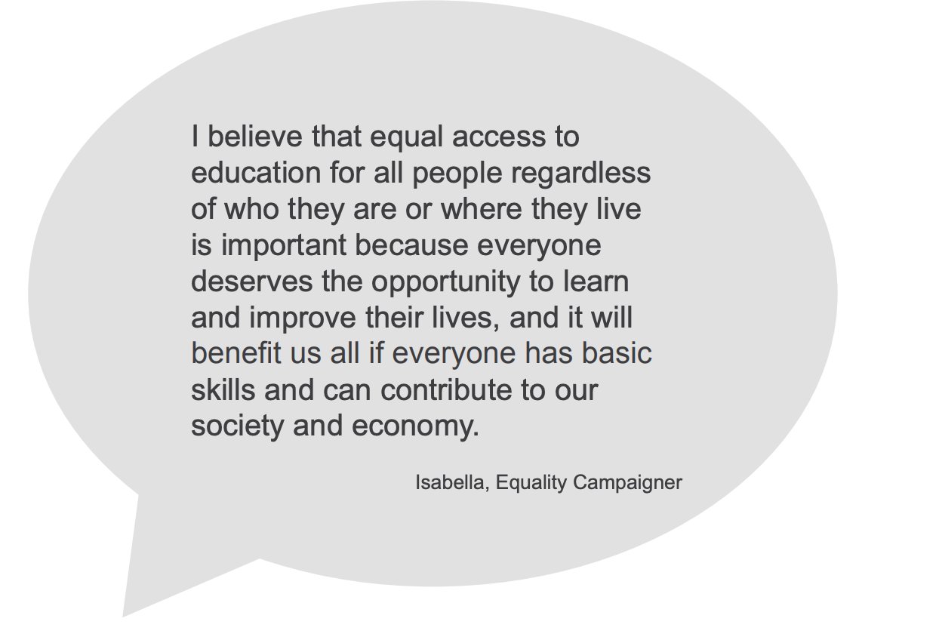
// Reduced Inequalities //
Teaching Learning Unit
Group Activity – types of inequality
-Can you think of any characteristics or situations that may cause inequality?
Other examples;
STEP 3
In your groups, can you think of any national and global examples of these inequalities?

Slide 11
// Reduced Inequalities //
Teaching Learning Unit
Inequality in the UK post Covid-19
In your groups you have provided lot’s of good examples of how inequality impacts the UK. But what does this look like after Covid-19?
Lower earners in the UK are more likely to have worked in sectors that have been shut down since lockdown began in March meaning a significant drop in their families income
BAME communities are the most likely to work in sectors recently locked down. Black communities are also both disproportionately in key worker occupations while also contracting the virus at far higher rates than their white counterparts.
With sectors like hospitality under more pressure than ever, it appears a pandemic-fuelled financial crash might create a perfect storm for young people with fewer prospects and increased insecurity.
The poorest people in our society aren’t just more likely to be hit harder economically by the fallout from the pandemic, but are more likely to have poorer health outcomes too.
Children home from school and living rooms transformed into temporary offices have resulted in the reinforcement of traditional gender roles, with mothers assuming more childcare and housework responsibilities than fathers.
Although almost all children and teenagers have been forced to learn from home as schools have shut across the country, there’s a divide in the effectiveness of remote education, depending on your socioeconomic status. 55% of families from the richest backgrounds report schools in the state sector providing online classes, while just 40% from the poorest families have said the same.
STEP 3
Global Citizens (2020)

Slide 12
// Reduced Inequalities //
Teaching Learning Unit
Global inequality post Covid-19?
Whilst different countries all over the world face both similar and different challenges of inequality, Covid-19 has further exasperated these inequalities, as we know that it is often the most poorest and most vulnerable countries that are hit the hardest….
Rohingya, Myanmar - The Rohingya have faced decades of discrimination and repression. They are one of the largest stateless populations in the world. About 900,000 Rohingya are currently living in overcrowded camps drastically increasing the risk of spreading Covid-19 with no healthcare, improper sanitation and inadequate education and access to health and safety information.
Beirut, Lebanon – After the recent explosion in the Port of Beirut, over 4,000 people were left injured and homeless. This has put increasing pressure on the healthcare system with hospitals having to turn patients away because they don’t have enough room. The Port that exploded was the epicentre for importing food and medicine needed to keep citizens healthy and protected from Covid-19.
However, more affluent countries, much like the UK, are facing real challenges of inequality too…
United States of America – with many American citizens already struggling to afford adequate healthcare, many of them have been left without the money to pay for treatment if they contract Covid-19. This means that those American citizens from lower socioeconomic households are more likely to contract the virus due to being more likely employed in essential key worker jobs, unable to shield or self-isolate and less likely to receive the care they need when catching the virus.
STEP 3
United Nations (2020) and World Health Organisation (2020)

Slide 13
// Reduced Inequalities //
Teaching Learning Unit
Raising Awareness Campaigns
  How can you raise awareness of these inequalities?
  In your groups, choose an inequality we have discussed in the session (examples = gender, disability, race etc).
  2.Research your chosen inequality to find out more starting with the resources provided
  3. In your groups, plan an awareness campaign of your chosen inequality to spread awareness to others
  4. Feedback your ideas to the class
STEP 3

Slide 14
// Reduced Inequalities //
Teaching Learning Unit
Raising Awareness Campaign Resources
Gender
Disability
https://unfoundation.org/blog/post/shadow-pandemic-how-covid19-crisis-exacerbating-gender-inequality/
https://www.inclusionlondon.org.uk/wp-content/uploads/2020/06/Abandoned-Forgotten-and-Ignored-Final-1.pdf
Age
Race
https://www.britishscienceassociation.org/news/new-survey-results-almost-9-in-10-young-people-feel-scientists-and-politicians-are-leaving-them-out-of-the-covid-19-conversation?gclid=Cj0KCQjw-O35BRDVARIsAJU5mQVITu4Vhg57bFN8NJqZTFvdT0B2jThL_DtrN73a14vxCaghULfxElsaAlzTEALw_wcB
https://theconversation.com/coronavirus-weekly-racism-covid-19-and-the-inequality-that-fuels-these-parallel-pandemics-140255
Socioeconomic Status
How to start an awareness campaign guide
https://www.ifs.org.uk/inequality/covid-19-and-inequalities/
https://www.niezlaakcja.pl/images/pdf/EN.pdf

Slide 15
// Reduced Inequalities //
Teaching Learning Unit
Reflection: What do you think?
1] What kind of challenges do you expect for equality Covid-19?
2] How can different countries Build Back Better?
3] What can you do to support equality post Covid-19?
4] Will the impact of Covid-19 on equality be greater in some parts of the world? How can we work together support these countries in the future?
STEP 3

Slide 16

// Reduced Inequalities //
Teaching Learning Unit
STEP 3

