Slide 1
// INTERNATIONAL INEQUALITIES // Teaching Learning Unit Responding to the Global Pandemic
Lesson 1 Meeting the SDG targets of 2030 ‘Build Back Better’- A Global Response to Covid 19
How has Covid impacted on the SDG targets?
How have the Sustainable Development Goals been impacted by the global pandemic of 2020? How do we Build Back Better?

Slide 2
// INTERNATIONAL INEQUALITIES //Teaching Learning Unit Responding to the Global Pandemic
Lesson 1 Meeting the SDG targets of 2030 ‘Build Back Better’- A Global Response to Covid 19
LEARNING OBJECTIVES OF THIS PHASE
Lesson 1
Students will be able to:
Reflect on the ways that people across the planet are living interconnected lifes .
Develop opinions on the statement ‘ build back better’.
Make connections between the Sustainable Development Goals and the impact of Covid 19.
Reflect on their own key principles about planning for a better future using the UN themes and the 5 Ps used by the UN [ people, prosperity, planet, peace and partnerships.
FROM THE SAT
DURATION
BIG IDEA
WHAT IS IT
1hour
WHAT TEACHER DOES – lesson start [ 5 minutes]
The teacher introduces lesson title and objectives and initial idea of the idea that as a result of the global pandemic we are more connected than ever.
Starter: Key Question: Is the world more interconnected than ever as a result of the global pandemic? Slide 7 Class discussion
. 5 minutes
ACTIVITY 1: - introduced by the teacher [ 10 minutes]
Activity 0ne Think- Pair- Share Discuss with a partner: ‘ What does Build Back better mean?’ slide 8
Consider this as a question for both the UK and the world.
What are your 3 priorities for the future.
Now join another pair and share your thoughts
Teacher introduces or revisits the SDGS, shows pupils the 17 targets and the key principles- slides 9, 10, 11 [10 minutes]
ACTIVITY 2 10 minutes
Reflecting in the new post Covid 19 world
How do these 4 principles fit with your priorities for building back better for the future?

Slide 3
// INTERNATIONAL INEQUALITIES //Teaching Learning Unit Responding to the Global Pandemic
Lesson 1 Meeting the SDG targets of 2030 ‘Build Back Better’- A Global Response to Covid 19
FROM THE SAT The Big Ideas
Big Ideas on International Inequality : GOVERNMENTAL ACTION ON INEQUALITY
Students can outline the significance of the SDGs,
How I act
1] Students can question and challenge assumptions about the world as it is today post Covid 19
2] Students can think about and change the way they live their lives so that people and the planet are not negatively affected by their choices
3] Students try to consider how they can inspire and engage others to learn about and take action on global challenges today.
Global Skills
Students try to consider things from different peoples viewpoints
Students are encouraged to think about how we can all make a better future and what they can do to help
Activity Three How can we transform the world Post Covid ? 20 minutes
Make 5 pledges these will be the 5 things you want to do to support the global goals and contribute to a better world
Have a look at the pledges on the next slide made by the UN.
These use the 5 Ps- People, Prosperity , Planet, Peace and Partnership
This could be done in groups on flip chart paper
Reflection 5 minutes
Write your one wish for the future on a post it note and share with a friend before you leave the classroom today
ACTIVITY 1: - introduced by the teacher [ 10 minutes]

Slide 4
// INTERNATIONAL INEQUALITIES // Teaching Learning Unit Responding to the Global Pandemic
Lesson 1 Meeting the SDG targets of 2030 ‘Build Back Better’- A Global Response to Covid 19
Lesson Title
‘Build Back Better’- A Global Response to Covid 19
Meeting the SDG targets

Slide 5
// INTERNATIONAL INEQUALITIES // Teaching Learning Unit Responding to the Global Pandemic
Lesson 1 Meeting the SDG targets of 2030 ‘Build Back Better’- A Global Response to Covid 19
Lesson Objectives
Students will be able to:
Reflect on the ways that people across the planet are living interconnected lifes .
Develop opinions on the statement ‘ build back better’.
Make connections between the Sustainable Development Goals and the impact of Covid 19.
Reflect on their own key principles about planning for a better future using the UN themes and the 5 Ps used by the UN [ people, prosperity, planet, peace and partnerships.

Slide 6
// INTERNATIONAL INEQUALITIES // Teaching Learning Unit Responding to the Global Pandemic
Lesson 1 Meeting the SDG targets of 2030 ‘Build Back Better’- A Global Response to Covid 19
The Big Ideas
Big Ideas on International Inequality : GOVERNMENTAL ACTION ON INEQUALITY
Students can outline the significance of the SDGs,
How I act
1] Students can question and challenge assumptions about the world as it is today post Covid 19
2] Students can think about and change the way they live their lives so that people and the planet are not negatively affected by their choices
3] Students try to consider how they can inspire and engage others to learn about and take action on global challenges today.
Global Skills
Students try to consider things from different peoples viewpoints
Students are encouraged to think about how we can all make a better future and what they can do to help

Slide 7
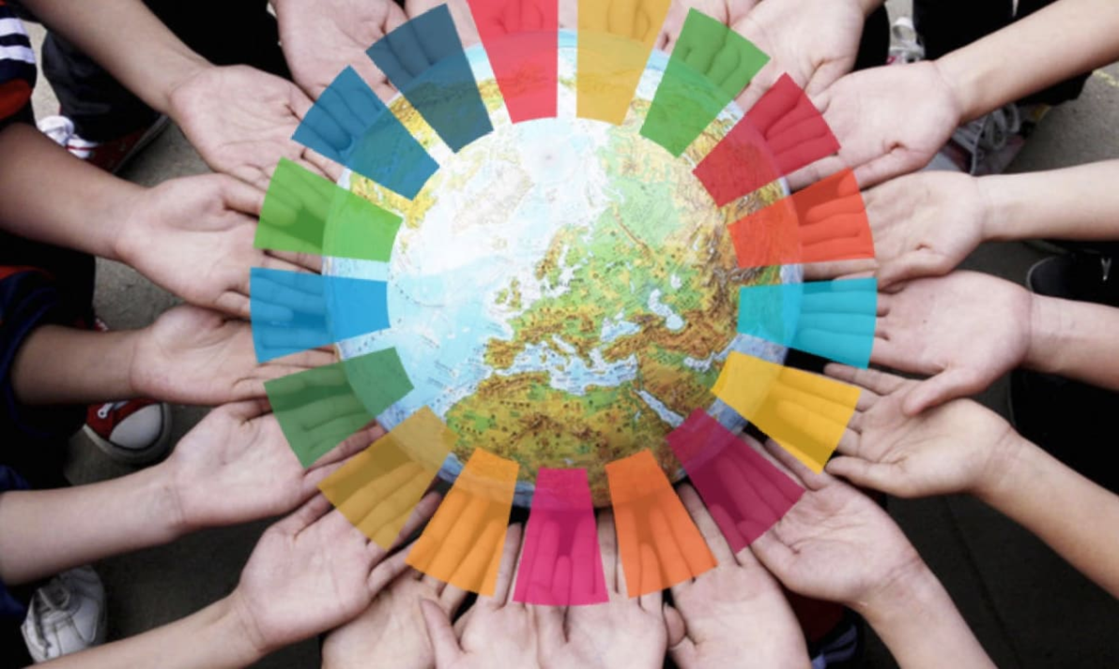
// INTERNATIONAL INEQUALITIES // Teaching Learning Unit Responding to the Global Pandemic
Lesson 1 Meeting the SDG targets of 2030 ‘Build Back Better’- A Global Response to Covid 19
Initial Idea
Is the world more interconnected than ever as a result of the global pandemic?

Slide 8
// INTERNATIONAL INEQUALITIES // Teaching Learning Unit Responding to the Global Pandemic
Lesson 1 Meeting the SDG targets of 2030 ‘Build Back Better’- A Global Response to Covid 19
Activity 0ne Think- Pair- Share
Discuss with a partner: ‘ What does Build Back better mean?’
Consider this as a question for both the UK and the world.
What are your 3 priorities for the future.
Now join another pair and share your thoughts

Slide 9
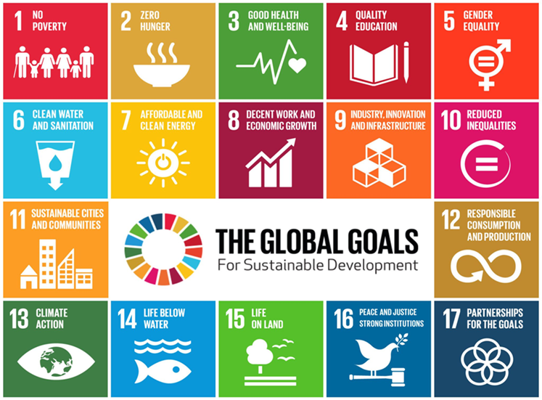
// INTERNATIONAL INEQUALITIES // Teaching Learning Unit Responding to the Global Pandemic
Lesson 1 Meeting the SDG targets of 2030 ‘Build Back Better’- A Global Response to Covid 19
The SDGs- what are they?
These are a set of goals and targets aimed at making the world a better place.
All the member states of the United Nations have committed to the 17 goals which if achieved would make the worlds environments, economies and societies better by 2030.
They are also known as ‘Global Goals’ , they apply to all people, young and old, in the UK and in everyone of the 193 countries that signed up to them in 2015.
It is the responsibility of all governments to ensure that countries move towards the targets set out in these goals. But we can all play an important part in achieving them.
Many schools are now integrating the SDGs into the school curriculum in PSHE and Citizenship and extra curricula activities through Eco Councils etc.
Do you know all 17 SDGs?
https://www.youtube.com/watch?time_continue=18&v=0XTBYMfZyrM&feature=emb_logo
Notes:
https://www.youtube.com/watch?time_continue=18&v=0XTBYMfZyrM&feature=emb_logo

Slide 10
The use of the SDGs to build a better world has 4 key principles:
1. We are all in this together
2. We need an all round approach
3.We must not leave anyone behind
4. Everyone is involved
Global Goals principles
“
No one left behind, ensuring human rights are enjoyed by all
Sustainable development at the core, transforming our use of natural resources
Changed patterns of consumption and production, creating a more equitable world
Peace and accountability for all states and Institutions, promoting the well being of all
Partnerships for global social justice, merging environment and development agendas.

Slide 11
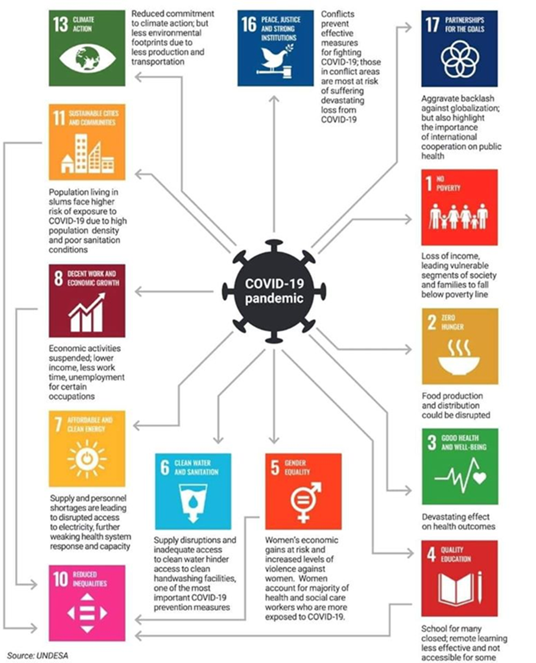
// INTERNATIONAL INEQUALITIES // Teaching Learning Unit Responding to the Global Pandemic
Lesson 1 Meeting the SDG targets of 2030 ‘Build Back Better’- A Global Response to Covid 19
The SDGs - Why do they matter more now than ever?

Slide 12
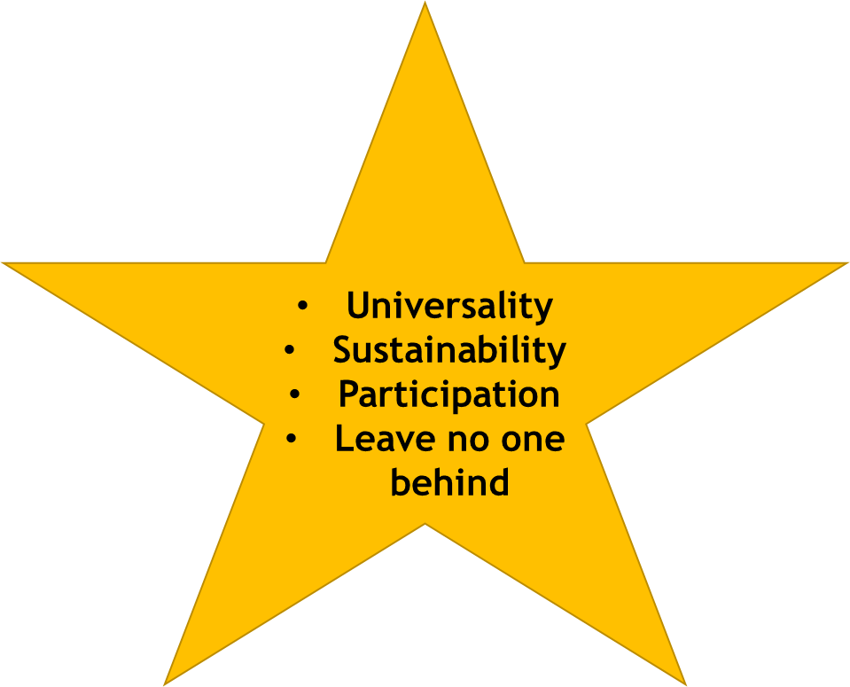
// INTERNATIONAL INEQUALITIES // Teaching Learning Unit Responding to the Global Pandemic
Lesson 1 Meeting the SDG targets of 2030 ‘Build Back Better’- A Global Response to Covid 19
Activity Two
Reflecting in the new post Covid 19 world
DISCUSS
How do these 4 principles fit with your priorities for building back better for the future?
1. The SDGs are intended to be universal in the sense of a universally shared common global vision of progress towards a safe, just and sustainable space for all human beings to thrive on the planet.
2. They reflect the moral principles that no-one and no country should be left behind, and that everyone and every country should be regarded as having a common responsibility for playing their part in delivering the global vision.
The Key principles of the Global Goals

Slide 13
// INTERNATIONAL INEQUALITIES // Teaching Learning Unit Responding to the Global Pandemic
Lesson 1 Meeting the SDG targets of 2030 ‘Build Back Better’- A Global Response to Covid 19
Activity Three How can we transform the world Post Covid ?
Make 5 pledges these will be the 5 things you want to do to support the global goals and contribute to a better world
Have a look at the pledges on the next slide made by the UN.
These use the 5 Ps- People, Prosperity , Planet, Peace and Partnership

Slide 14
// INTERNATIONAL INEQUALITIES // Teaching Learning Unit Responding to the Global Pandemic
Lesson 1 Meeting the SDG targets of 2030 ‘Build Back Better’- A Global Response to Covid 19
Modelling the pledges
Activity Three How can we transform the world?
The UN Key ideas are based around the 5 Ps. Transforming our world: the 2030 Agenda for Sustainable Development The Goals and targets will stimulate action over the next fifteen years in areas of critical importance for humanity and the planet:
Planet
We are determined to protect the planet from degradation, including through sustainable consumption and production, sustainably managing its natural resources and taking urgent action on climate change, so that it can support the needs of the present and future generations.
People
We are determined to end poverty and hunger, in all their forms and dimensions, and to ensure that all human beings can fulfil their potential in dignity and equality and in a healthy environment.
Prosperity
We are determined to ensure that all human beings can enjoy prosperous and fulfilling lives and that economic, social and technological progress occurs in harmony with nature.
Peace
We are determined to foster peaceful, just and inclusive societies which are free from fear and violence. There can be no sustainable development without peace and no peace without sustainable development.
Partnership
We are determined to mobilize the means required to implement this Agenda through a revitalised Global Partnership for Sustainable Development, based on a spirit of strengthened global solidarity, focussed in particular on the needs of the poorest and most vulnerable and with the participation of all countries, all stakeholders and all people.
Notes:
https://sustainabledevelopment.un.org/post2015/transformingourworld

Slide 15
Meeting the SDG targets of 2030 ‘Build Back Better’- A Global Response to Covid 19
Transformation of the planet Post Covid- Make 5 pledges 5 things you want to do to support the global goals and contribute to a better world
People
Prosperity
Planet
Peace
Partnership

Slide 16
// INTERNATIONAL INEQUALITIES // Teaching Learning Unit Responding to the Global Pandemic
Lesson 1 Meeting the SDG targets of 2030 ‘Build Back Better’- A Global Response to Covid 19
Reflection
Write your one wish for the future on a post it note and share with a friend before you leave the classroom today

