Slide 1
Responding to the Global Pandemic // CLIMATE CHANGE //Teaching Learning Unit Lesson 2 ‘Build Back Better’- A Global Response to Covid 19 and the challenge of climate change
Mental Map
After the Covid-19 crisis, will we get a greener world?

Slide 2
Responding to the Global Pandemic // CLIMATE CHANGE //Teaching Learning Unit Lesson 2 ‘Build Back Better’- A Global Response to Covid 19 and the challenge of climate change
Lesson 2
LEARNING OBJECTIVES OF THIS PHASE
BIG IDEA
WHAT IS IT
Lesson
2
Students will be able to:
Reflect on ways that the people living on planet earth are interconnected.
Examine the impact of Covid 19 on climate change
Critically reflect on how we can as a global community ‘ build back better’ to protect the planet and help work towards meeting the SDG targets for 2030
How I act
1] Students can question and challenge assumptions about the world as it is today post Covid 19
2] Students can think about and change the way they live their lives so that people and the planet are not negatively affected by their choices
3] Students try to consider how they can inspire and engage others to learn about and take action on global challenges today.
Global Skills
Students try to consider things from different peoples viewpoints
Students are encouraged to think about how we can all make a better future and what they can do to help
DURATION
1h
WHAT TEACHER DOES 5 mins
Teacher introduces the theme of the lesson and the lesson objectives,
Activity One: Think-Pair-Share Think – Pair- Share 5 minutes
Show pupils the Unicef image on slide 7 Why do you think UNICEF have made this statement? Discuss your ideas and opinions on this.
Activity Two Teacher Instructions: 20 minutes
You can either show one of the video clips on slide 10 0r 11 or get the pupils working together looking at images [ these can be printed out and put round the room].
Reflecting on Images Activity Two A : Discuss in small groups
Examine each picture and answer the key questions: What words and emotions come straight into your head when you see this image? ‘What is happening in the picture? How does this picture make you feel? Can you see any link with Covid 19? How is there a link between this picture and climate change[ the planet?} [ slides 14 to 19]
IActivity Two B : Discuss in small groups Think about what you saw in the video clips and discuss:
What words and emotions come straight into your head whilst you were watching this clip? What was happening in the clip? How does this clip make you feel? Can you see any link with Covid 19? How is there a link between this picture and climate change[ the planet?}
ITY 2

Slide 3
Responding to the Global Pandemic // CLIMATE CHANGE //Teaching Learning Unit Lesson 2 ‘Build Back Better’- A Global Response to Covid 19 and the challenge of climate change
BIG IDEA
WHAT IS IT
Students can outline the significance of the SDGs.
Students can explain the significance of the threat that Climate Change potentially poses to life-forms on earth.
Students are able to make the link between patterns of human consumption and Climate Change.
Students can name some different consequences of climate change and how these affect people, animals and plants.
Students understand that Climate Change will have an effect on the future of their and the lives of everyone in the world. They know that there are a number of different possible futures, and what individuals and the global community as a whole do now, will determine the probable future in terms of life on Earth. They can name consequences if we do not take care of the environment and understand Climate Change is an environmental threat to human civilisation on a planetary scale.
Students understand that action on Climate Change is taking place at 3 levels across the world. They can explain why action on all of these levels is important to address Climate Change. They can explain the importance of the role that individuals can play. Students understand that there frequently a disjuncture between people’s awareness of the problem and people actually changing their behavio
ACTIVITY 3 – slides 20 to 27 10 minutes
Teacher can use slides to talk to class about the SDGS, the impact of climate change and how it will affect young people in the future.
Activity Three 20 minutes
Is this a moment to rethink how we live on the planet as a result of the global pandemic? How do you think we should move forward?
Pupils work in groups and develop a green recovery plan [ this could be done on flip chart paper , display these around the room for a final reflection
Reflection 5 minutes
Is this a moment to rethink how we live on the planet as a result of the global pandemic? How do you think we should move forward?
Please walk around and look at your classes recovery plan.
Pick one idea that you really like and write it on a post it note- these will form the basis of a shared class plan
ACTIVITY 4
-

Slide 4
Responding to the Global Pandemic // CLIMATE CHANGE //Teaching Learning Unit Lesson 2 ‘Build Back Better’- A Global Response to Covid 19 and the challenge of climate change
COMMENTS & NOTES ON REALIZATION
Links to PSHE curriculum : Living in the Wider World Core theme 3 L1
Links to Citizenship :Pupils are equipped with the skills to think critically and debate political questions[ EG climate change] debate and evaluate viewpoints and present reasoned arguments . Show knowledge of the ways that citizens can work together to improve their communities , knowledge of forms of responsible action ,
knowledge of relations with Europe, the Commonwealth, the UN and the wider world.
This lesson could be spread over more than 1 lesson

Slide 5
Responding to the Global Pandemic // CLIMATE CHANGE //Teaching Learning Unit Lesson 2 ‘Build Back Better’- A Global Response to Covid 19 and the challenge of climate change
The Big Ideas
Students can outline the significance of the SDGs.
Students can explain the significance of the threat that Climate Change potentially poses to life-forms on earth.
Students are able to make the link between patterns of human consumption and Climate Change.
Students can name some different consequences of climate change and how these affect people, animals and plants.
Students understand that Climate Change will have an effect on the future of their and the lives of everyone in the world. They know that there are a number of different possible futures, and what individuals and the global community as a whole do now, will determine the probable future in terms of life on Earth. They can name consequences if we do not take care of the environment and understand Climate Change is an environmental threat to human civilisation on a planetary scale.
Students understand that action on Climate Change is taking place at 3 levels across the world. They can explain why action on all of these levels is important to address Climate Change. They can explain the importance of the role that individuals can play. Students understand that there frequently a disjuncture between people’s awareness of the problem and people actually changing their behaviour

Slide 6
Responding to the Global Pandemic // CLIMATE CHANGE //Teaching Learning Unit Lesson 2 ‘Build Back Better’- A Global Response to Covid 19 and the challenge of climate change
The Big Ideas
How I act
1] Students can question and challenge assumptions about the world as it is today post Covid 19
2] Students can think about and change the way they live their lives so that people and the planet are not negatively affected by their choices
3] Students try to consider how they can inspire and engage others to learn about and take action on global challenges today.
Global Skills
Students try to consider things from different peoples viewpoints
Students are encouraged to think about how we can all make a better future and what they can do to help

Slide 7
Responding to the Global Pandemic // CLIMATE CHANGE //Teaching Learning Unit Lesson 2 ‘Build Back Better’- A Global Response to Covid 19 and the challenge of climate change
Climate Change and Covid 19
Title
Build Back Better- A Global Response to Covid 19
After the Covid-19 crisis, will we get a greener world?

Slide 8
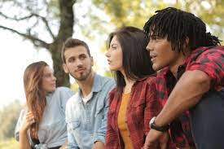
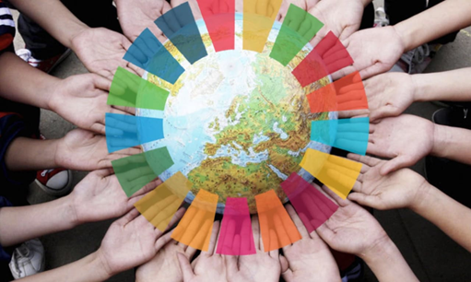
Responding to the Global Pandemic // CLIMATE CHANGE //Teaching Learning Unit Lesson 2
‘Build Back Better’- A Global Response to Covid 19 and the challenge of climate change
The SDGs and Climate Change
Climate Change and Covid 19Lesson Objectives
Students will be able to:
Reflect on ways that the people living on planet earth are interconnected.
Examine the impact of Covid 19 on climate change
Critically reflect on how we can as a global community ‘ build back better’ to protect the planet and help work towards meeting the SDG targets for 2030
Notes:
https://pixabay.com/illustrations/corona-mask-world-together-virus-5002226/

Slide 9
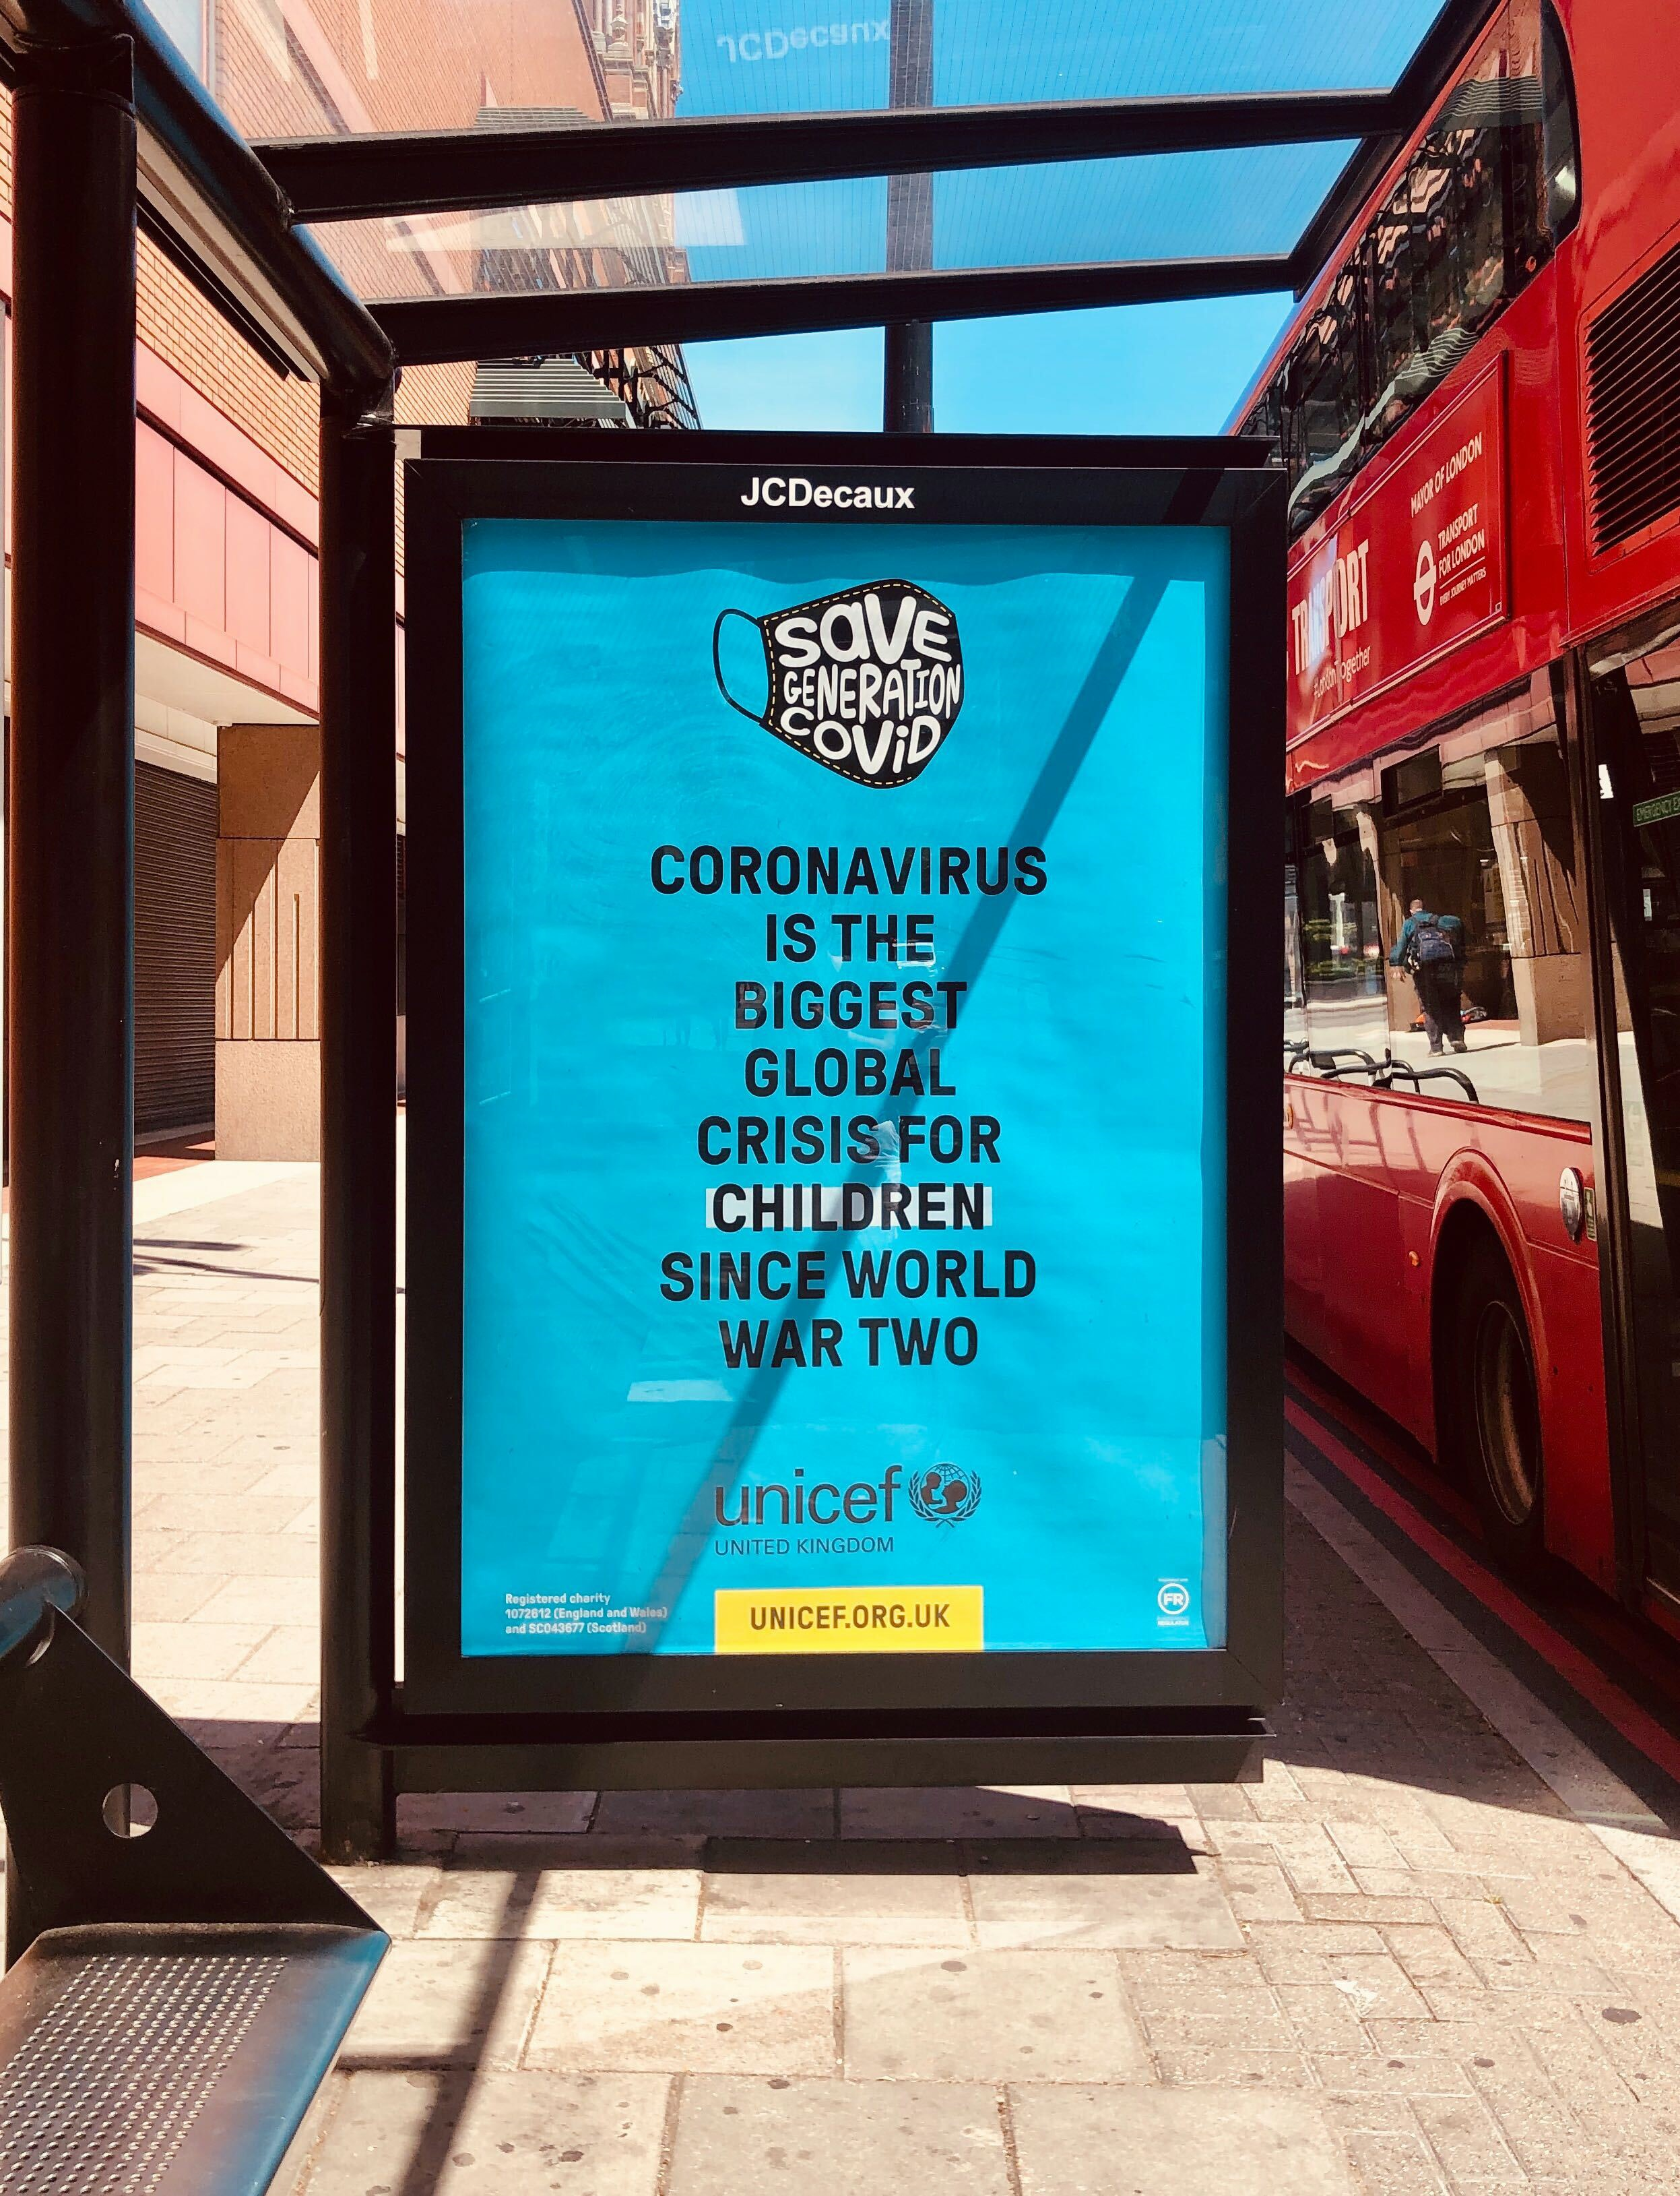
Responding to the Global Pandemic // CLIMATE CHANGE //Teaching Learning Unit Lesson 2
‘Build Back Better’- A Global Response to Covid 19 and the challenge of climate change
Activity One: Think-Pair-Share
Why do you think UNICEF have made this statement?
Discuss your ideas and opinions on this.
Notes:
https://unsplash.com/t/covid-19

Slide 10
Responding to the Global Pandemic // CLIMATE CHANGE //Teaching Learning Unit Lesson 2
‘Build Back Better’- A Global Response to Covid 19 and the challenge of climate change
Teacher Instructions:
You can either show one of the video clips on the next slide or get the pupils working together looking at images [ these can be printed out and put round the room].
Notes:
https://unsplash.com/t/covid-19

Slide 11
Responding to the Global Pandemic // CLIMATE CHANGE //Teaching Learning Unit Lesson 2 ‘Build Back Better’- A Global Response to Covid 19 and the challenge of climate change
The Guardian
'Nature is taking back Venice': wildlife returns to tourist-free city
https://www.theguardian.com/environment/2020/mar/20/nature-is-taking-back-venice-wildlife-returns-to-tourist-free-city

Slide 12
Responding to the Global Pandemic // CLIMATE CHANGE //Teaching Learning Unit Lesson 2 ‘Build Back Better’- A Global Response to Covid 19 and the challenge of climate change
2 short videos showing the impact of covid on the planet – pick one to show
https://www.youtube.com/watch?time_continue=8&v=HVwjs_D_kRI&feature=emb_logo
https://www.youtube.com/watch?v=tUV3KaLjl10
Notes:
2 short videos showing the impact of covid

Slide 13
Responding to the Global Pandemic // CLIMATE CHANGE //Teaching Learning Unit Lesson 2 ‘Build Back Better’- A Global Response to Covid 19 and the challenge of climate change
The SDGs and Climate Change
Reflecting on Images
Activity Two A : Discuss in small groups
Examine each picture and answer the key questions:
What words and emotions come straight into your head when you see this image? ‘What is happening in the picture?
How does this picture make you feel?
Can you see any link with Covid 19?
How is there a link between this picture and climate change[ the planet?}
Notes:
Or you could do Activity Two B ad reflect on the video , questions are on the next slide

Slide 14
Responding to the Global Pandemic // CLIMATE CHANGE //Teaching Learning Unit Lesson 2 ‘Build Back Better’- A Global Response to Covid 19 and the challenge of climate change
The SDGs and Climate Change
Reflecting on the clips
Activity Two B : Discuss in small groups
Think about what you saw in the video clips and discuss:
What words and emotions come straight into your head whilst you were watching this clip?
What was happening in the clip?
How does this clip make you feel?
Can you see any link with Covid 19?
How is there a link between this picture and climate change[ the planet?}

Slide 15
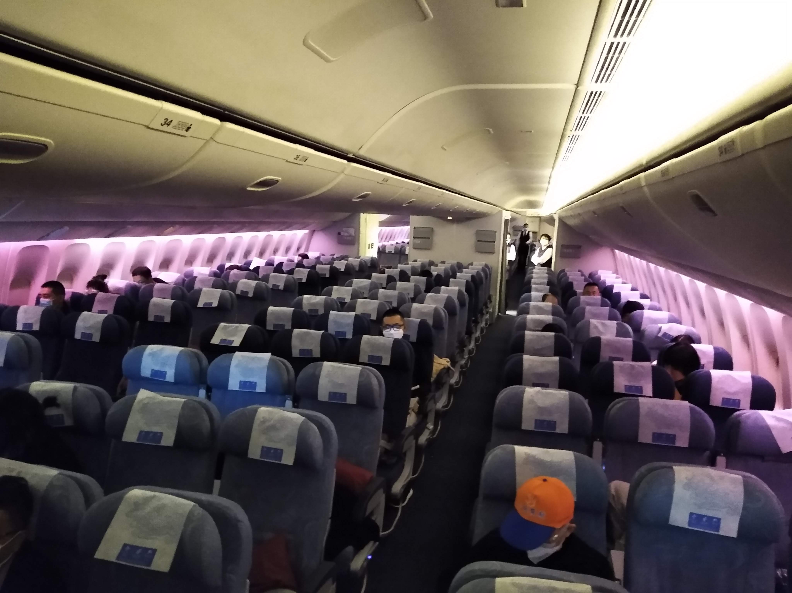
Responding to the Global Pandemic // CLIMATE CHANGE
Picture One
Notes:
https://commons.wikimedia.org/wiki/File:A_nearly_empty_flight_from_PEK_to_LAX_amid_the_COVID-19_pandemic_1.jpg

Slide 16
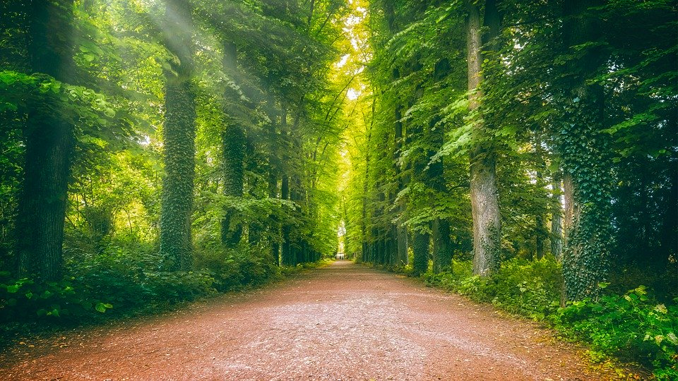
Responding to the Global Pandemic // CLIMATE CHANGE
Picture A
Notes:
https://pixabay.com/photos/away-avenue-forest-sun-rays-5348739/

Slide 17
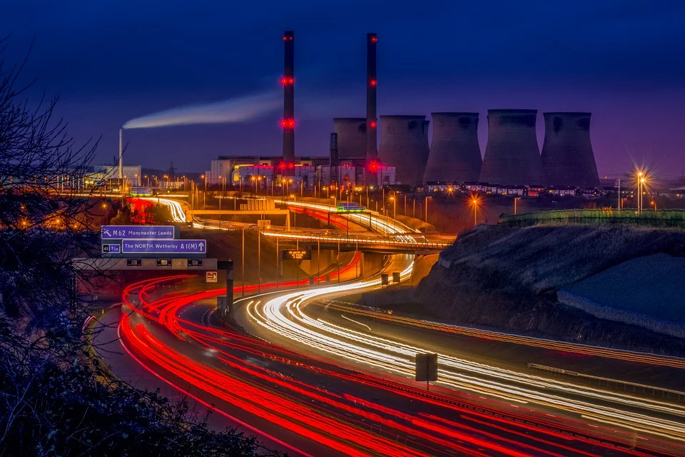
Responding to the Global Pandemic // CLIMATE CHANGE
Picture B
Notes:
https://pixabay.com/photos/power-station-light-trails-motorway-5428427/

Slide 18
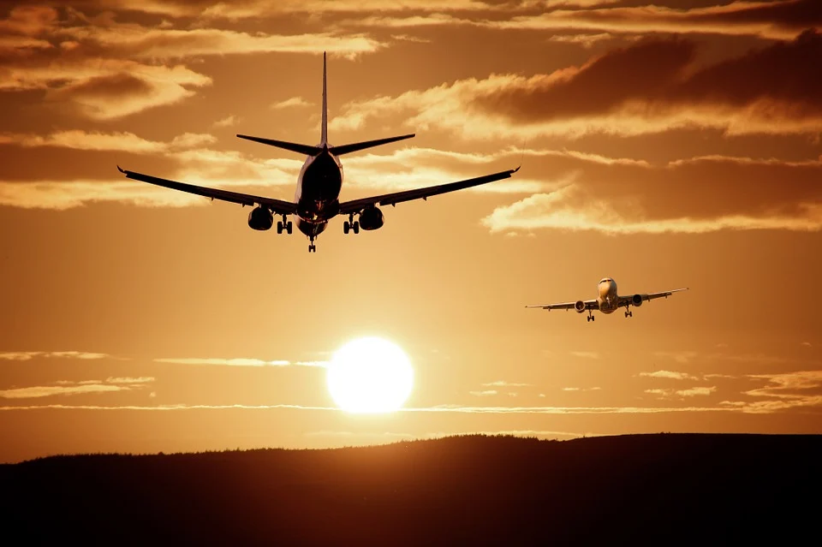
Responding to the Global Pandemic // CLIMATE CHANGE
Picture Two
Notes:
https://pixabay.com/photos/aircraft-landing-sky-silhouette-513641/

Slide 19
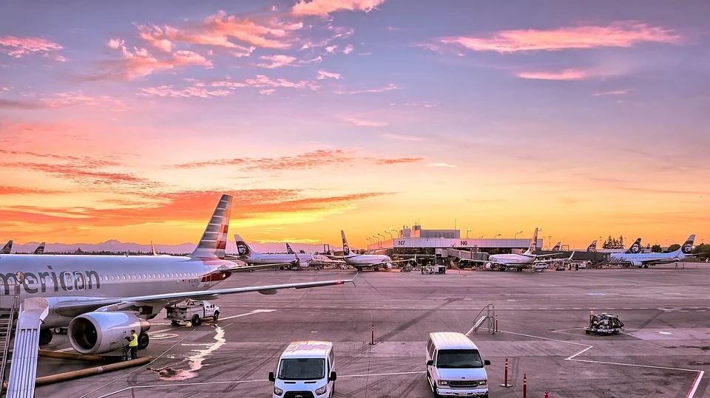
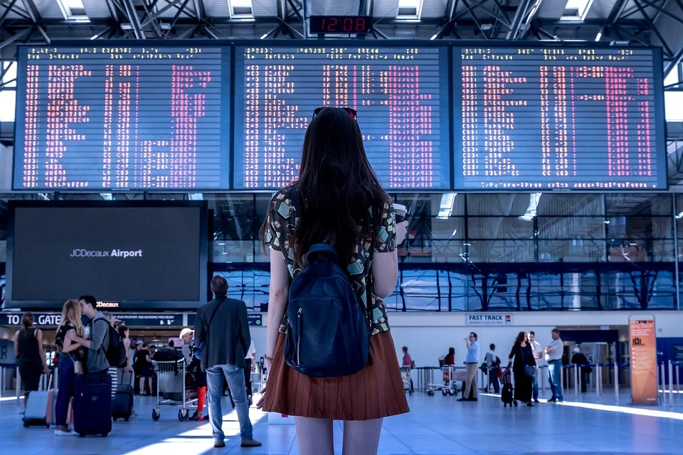
Responding to the Global Pandemic // CLIMATE CHANGE
Picture Three
Notes:
https://pixabay.com/photos/airport-airplanes-gates-flight-line-1553958/
https://pixabay.com/photos/airport-transport-woman-girl-2373727/

Slide 20
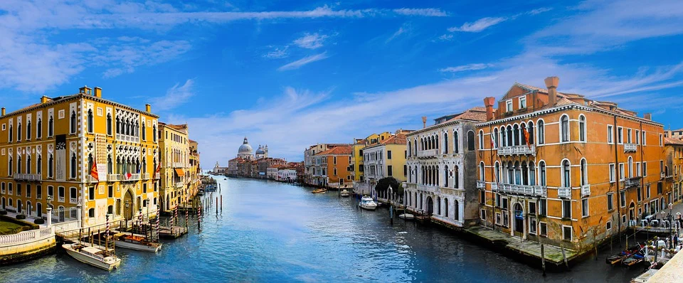
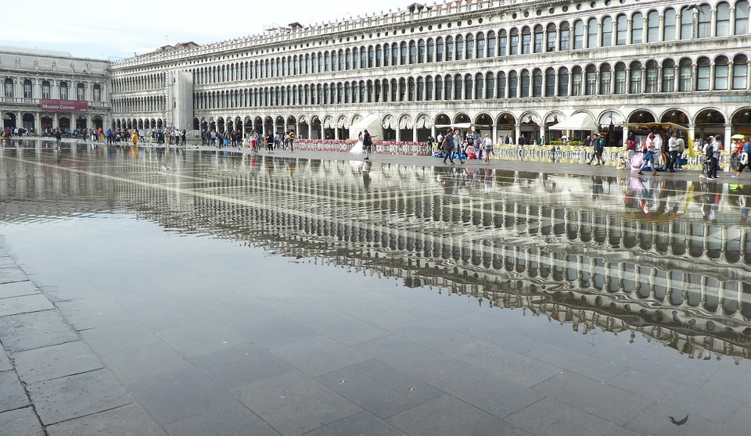
Responding to the Global Pandemic // CLIMATE CHANGE
Picture Four
Notes:
https://pixabay.com/photos/venice-architecture-channel-water-3130323/
https://pixabay.com/photos/venice-piazza-san-marco-italy-4559575/

Slide 21
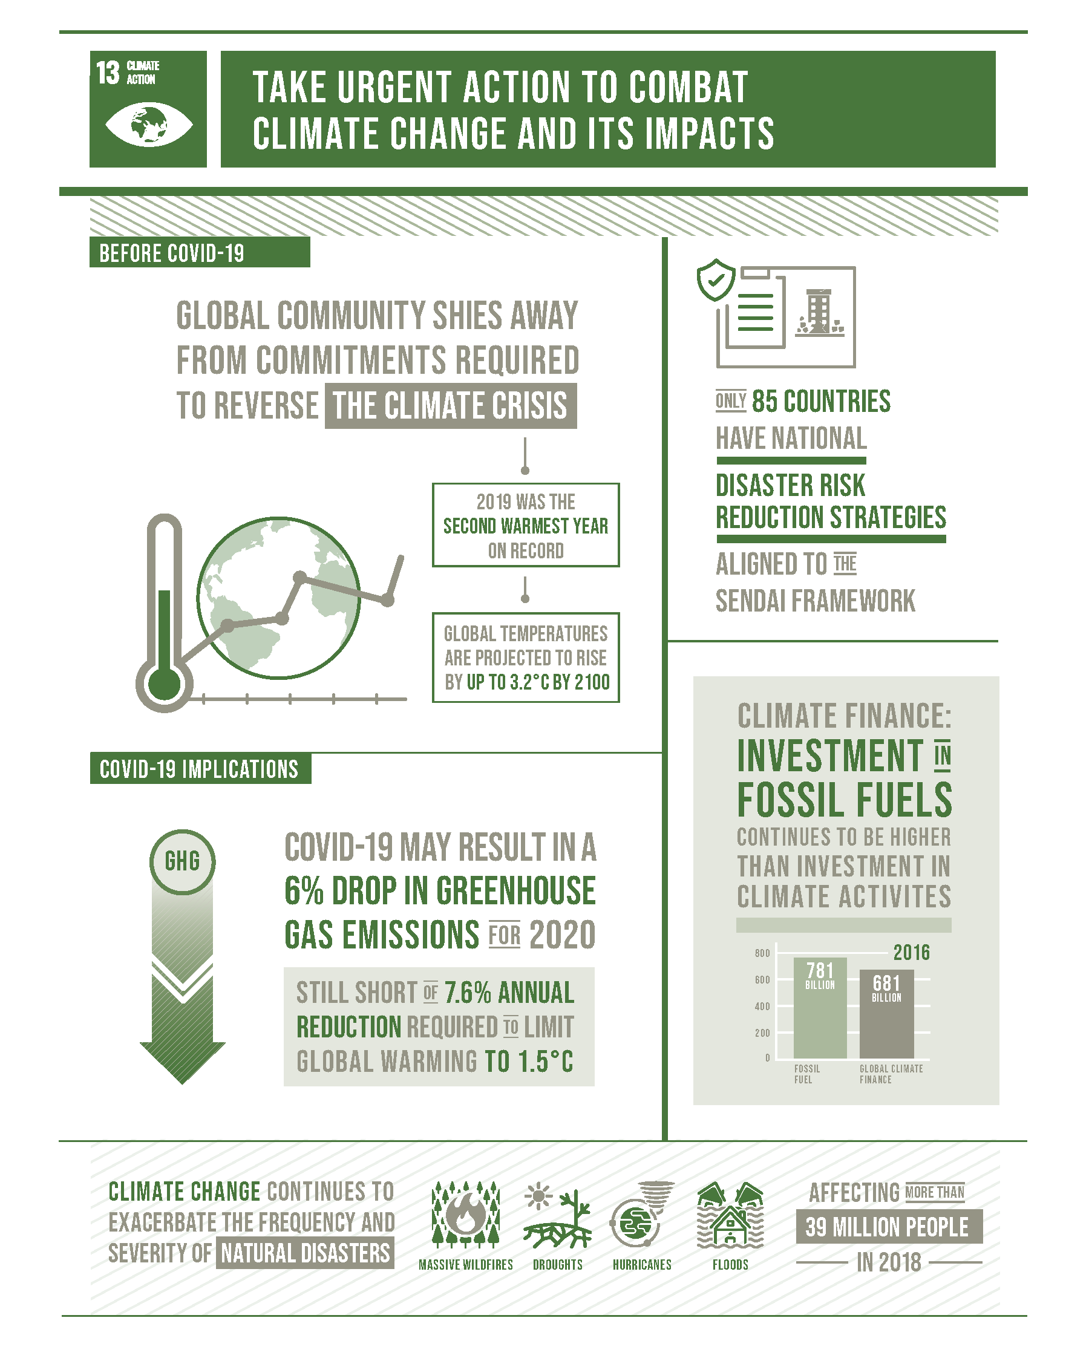
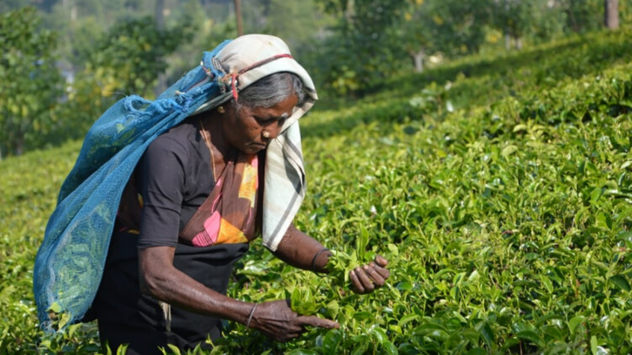
Responding to the Global Pandemic // CLIMATE CHANGE //Teaching Learning Unit Lesson 2 ‘Build Back Better’- A Global Response to Covid 19 and the challenge of climate change
In the opinions of many people the SDGs still offer one of the best options to reduce the worst impacts of COVID-19 and may help the world to recover better. However, there is also a concern that the world will have a reduced commitment to climate action but as a result of the global pandemic in 2020 there will be less environmental footprints due to less production and transportation.

Slide 22
Responding to the Global Pandemic // CLIMATE CHANGE //Teaching Learning Unit Lesson 2 ‘Build Back Better’- A Global Response to Covid 19 and the challenge of climate change
What about the threat of climate change?
No group is more vulnerable to environmental harm than children, as David Boyd, UN Special Rapporteur on human rights and the environment, explains.
“Every child on Earth, no matter what country they live in, should have the right to live, play and study in healthy environments,” says Boyd.
“Today, far too many children suffer from polluted air, contaminated water, and inadequate food. Also worrisome are the growing impacts of climate change and the decline of ecosystems and biodiversity, which will inflict increasing harm on children in the future, including more pandemics like COVID-19, unless current trends are reversed.”
Will coronavirus shutdowns really help fight climate crisis?

Slide 23
Responding to the Global Pandemic // CLIMATE CHANGE //Teaching Learning Unit Lesson 2 ‘Build Back Better’- A Global Response to Covid 19 and the challenge of climate change
"Covid-19 is the most urgent threat facing humanity today, but we cannot forget that climate change is the biggest threat facing humanity over the long term.
Will coronavirus shutdowns really help fight climate crisis?’’
‘‘Soon, economies will restart. This is a chance for nations to recover better, to include the most vulnerable in those plans, and a chance to shape the 21st century economy in ways that are clean, green, healthy, just, safe and more resilient.’’
UN climate chief Patricia Espinosa

Slide 24
Responding to the Global Pandemic // CLIMATE CHANGE //Teaching Learning Unit Lesson 2 ‘Build Back Better’- A Global Response to Covid 19 and the challenge of climate change
Coronavirus: 'Nature is sending us a message’, says Andersen, executive director of the UN Environment Programme,
Andersen said humanity was placing too many pressures on the natural world with damaging consequences, and warned that failing to take care of the planet meant not taking care of ourselves.
Leading scientists also said the Covid-19 outbreak was a “clear warning shot”, given that far more deadly diseases existed in wildlife, and that today’s civilisation was “playing with fire”. They said it was almost always human behaviour that caused diseases to spill over into humans.
To prevent further outbreaks, the experts said, both global heating and the destruction of the natural world for farming, mining and housing have to end, as both drive wildlife into contact with people.
Anderson also said: “But our long-term response must tackle habitat and biodiversity loss,”
“There are too many pressures at the same time on our natural systems and something has to give,” she added. “We are intimately interconnected with nature, whether we like it or not. If we don’t take care of nature, we can’t take care of ourselves. And as we hurtle towards a population of 10 billion people on this planet, we need to go into this future armed with nature as our strongest ally.”

Slide 25
Responding to the Global Pandemic // CLIMATE CHANGE //Teaching Learning Unit Lesson 2 ‘Build Back Better’- A Global Response to Covid 19 and the challenge of climate change
What the COVID-19 response can teach us about fighting climate change.
Nature is healing itself from all our inhumane actions against the planet. The planet is demonstrating its capacity to recover, if we give it a break. The planet provides for our food, shelter and basic needs, if we continue to damage it we will reach an irreversible point, where we will not be able to go back to normal life.
https://wearerestless.org/2020/03/20/what-the-covid-19-response-can-teach-us-about-fighting-climate-change/

Slide 26
Responding to the Global Pandemic // CLIMATE CHANGE //Teaching Learning Unit Lesson 2 ‘Build Back Better’- A Global Response to Covid 19 and the challenge of climate change
2020 Newspaper Headlines
Why don’t we treat climate change like an infectious disease?
Covid-19 lockdown will have 'negligible' impact on climate crisis – study
Drop in emissions was a blip, say scientists, and a green recovery is vital to halt global heating
'Tip of the iceberg': is our destruction of nature responsible for Covid-19?
Coronavirus: Wild animals enjoy freedom of a quieter world
Climate solutions ‘vital’ to ease Covid-19 impact
Climate solutions ‘vital’ to ease Covid-19 impact
The epidemic provides a chance to do good by the climate
Notes:
'Tip of the iceberg': is our destruction of nature responsible for Covid-19?
As habitat and biodiversity loss increase globally, the coronavirus outbreak may be just the beginning of mass pandemic the Guardian
https://www.bbc.co.uk/news/world-52459487
https://www.theguardian.com/environment/2020/aug/07/covid-19-lockdown-will-have-negligible-impact-on-climate-crisis-study

Slide 27
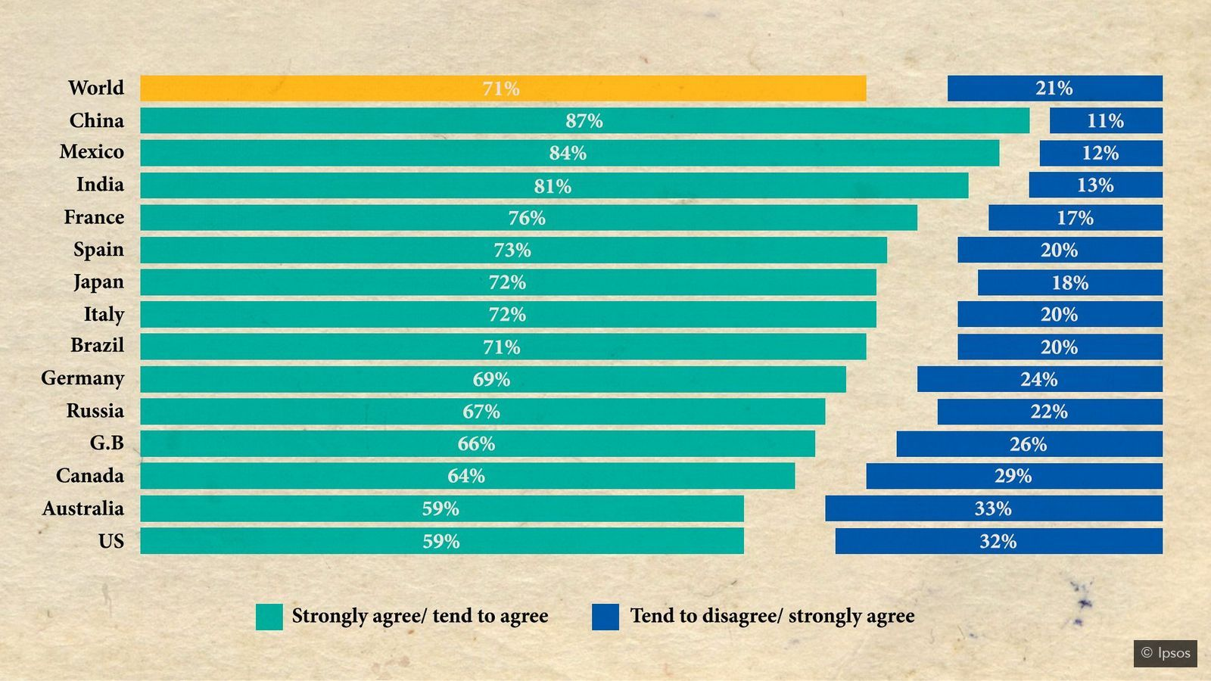
Responding to the Global Pandemic // CLIMATE CHANGE //Teaching Learning Unit Lesson 2 ‘Build Back Better’- A Global Response to Covid 19 and the challenge of climate change
An Ipsos Mori survey in April 2020 asked 28,029 adults whether they agreed with the question: in the long term, climate change is as serious a crisis as COVID-19 (Credit: Ipsos)

Slide 28
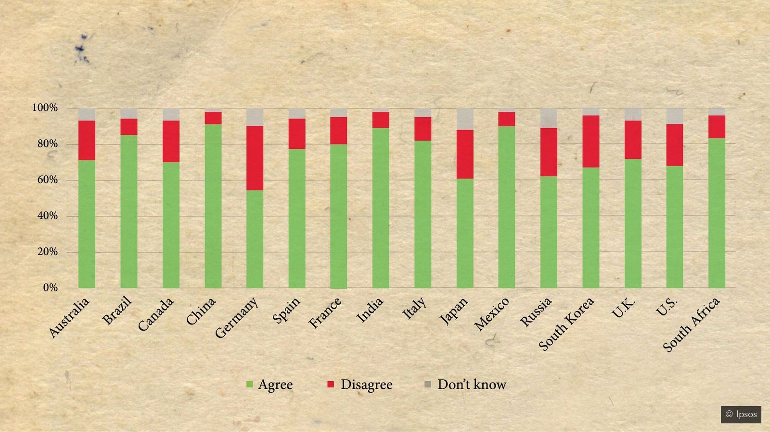
Responding to the Global Pandemic // CLIMATE CHANGE //Teaching Learning Unit Lesson 2 ‘Build Back Better’- A Global Response to Covid 19 and the challenge of climate change
Another Ipsos Mori survey asked international respondents if they thought their government should make environment protection a priority in recovery from Covid-19 (Credit: Ipsos)
Notes:
https://www.bbc.com/future/article/20200624-has-covid-19-brought-us-closer-to-stopping-climate-change

Slide 29
Responding to the Global Pandemic // CLIMATE CHANGE //Teaching Learning Unit Lesson 2 ‘Build Back Better’- A Global Response to Covid 19 and the challenge of climate change
Activity Three Planning for a green recovery
World economic forum video
https://www.weforum.org/agenda/2020/05/the-importance-of-climate-education-in-a-covid-19-world/
Notes:
https://www.afgsc.af.mil/News/Commentaries/Display/Article/1034948/reduce-reuse-recycle-a-clich-with-meaning/

Slide 30
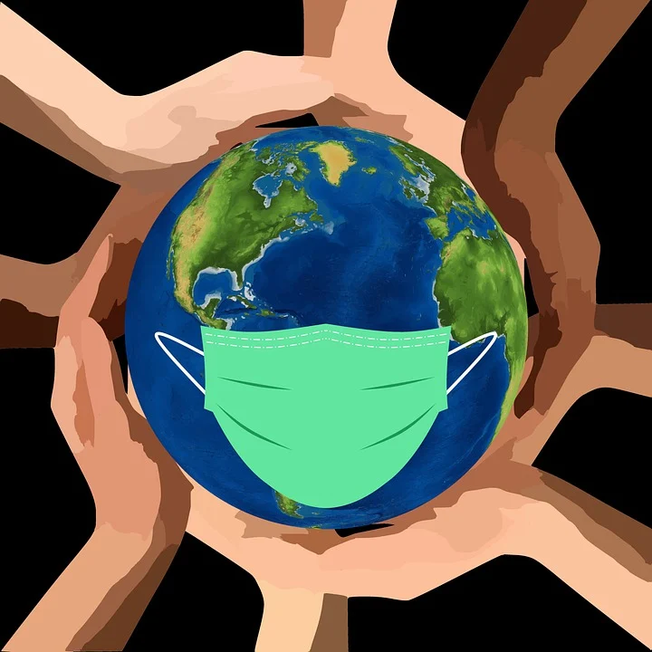
Responding to the Global Pandemic // CLIMATE CHANGE //Teaching Learning Unit
Lesson 2 ‘Build Back Better’- A Global Response to Covid 19 and the challenge of climate change
Activity Three
Is this a moment to rethink how we live on the planet as a result of the global pandemic? How do you think we should move forward?
“The human community is completely interconnected and interdependent….The overall problem is that we are not sustainable in the ways we are living and producing on the planet today,”
“The only way forward is to create a world that leaves no one behind.”
Lise Kingo, executive director of the UN Global Compact

Slide 31
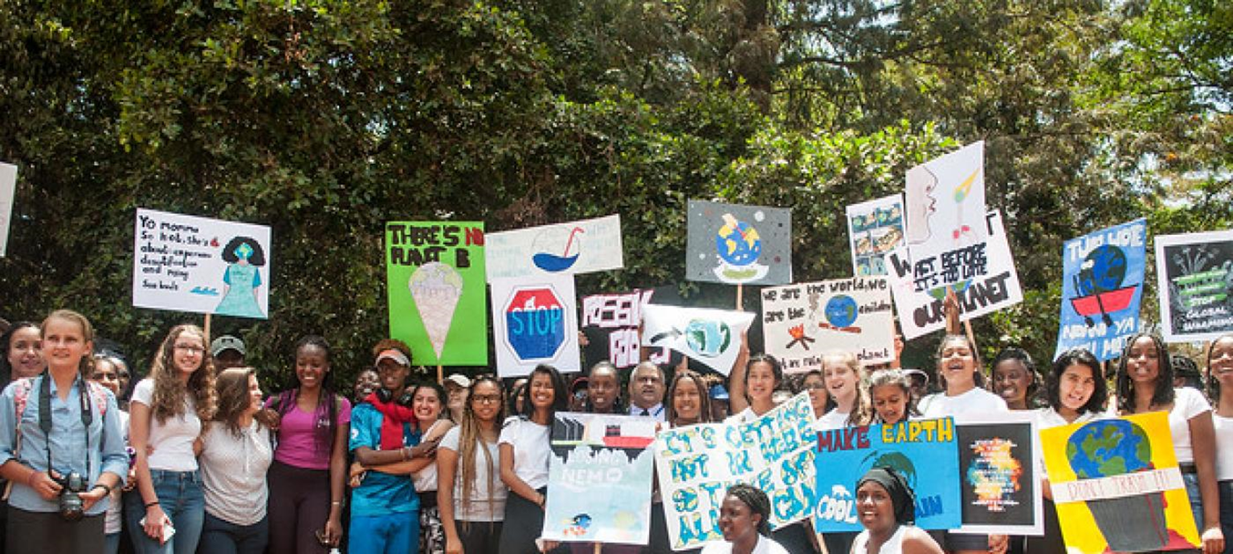
Planning for a green recovery
New York, 21 September 2019 – Fridays for Future, a dynamic global student movement inspired by Swedish teenage climate activist Greta Thunberg, has received the 2019 Champions of the Earth award, the UN’s highest environmental honour
Notes:
https://www.afgsc.af.mil/News/Commentaries/Display/Article/1034948/reduce-reuse-recycle-a-clich-with-meaning/
https://www.unenvironment.org/news-and-stories/press-release/fridays-future-named-un-champion-earth-award-passionately-demanding

Slide 32
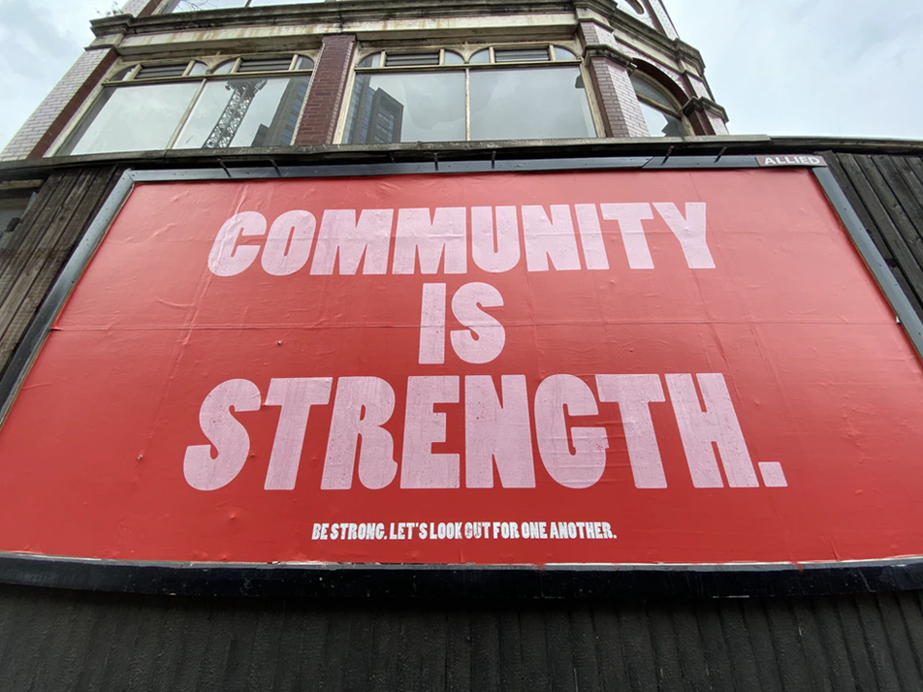
Responding to the Global Pandemic // CLIMATE CHANGE //Teaching Learning Unit Lesson 2 ‘Build Back Better’- A Global Response to Covid 19 and the challenge of climate change
Planning for a green recovery
Housing | Work
Transport | Daily Habitats
Fashion | Food choices
Travel | Rubbish
consumption | Heating
Each group will display their plan on a large piece of flip chart paper so everyone can see all the ideas.
Notes:
https://www.afgsc.af.mil/News/Commentaries/Display/Article/1034948/reduce-reuse-recycle-a-clich-with-meaning/

Slide 33
Responding to the Global Pandemic // CLIMATE CHANGE //Teaching Learning Unit Lesson 2 ‘Build Back Better’- A Global Response to Covid 19 and the challenge of climate change
Reflection Planning for a green recovery
Is this a moment to rethink how we live on the planet as a result of the global pandemic? How do you think we should move forward?
Please walk around and look at your classes recovery plan.
Pick one idea that you really like and write it on a post it note- these will form the basis of a shared class plan
Notes:
https://www.afgsc.af.mil/News/Commentaries/Display/Article/1034948/reduce-reuse-recycle-a-clich-with-meaning/

Slide 34
Responding to the Global Pandemic // CLIMATE CHANGE //Teaching Learning Unit Lesson 2 ‘Build Back Better’- A Global Response to Covid 19 and the challenge of climate change
Additional Resources

Slide 35
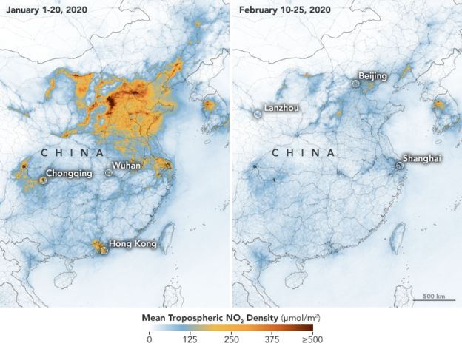
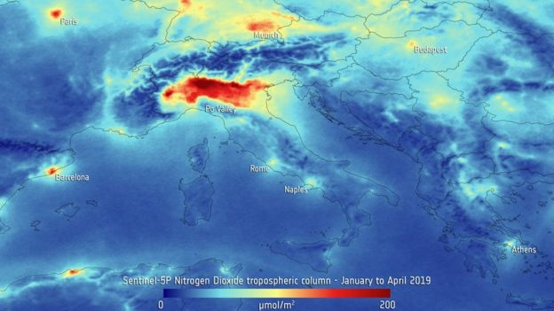
A European Space Agency satellite image showing levels of nitrogen dioxide over Italy
ESA
NASA
Notes:
https://www.bbc.co.uk/news/world-52459487

Slide 36
https://www.un.org/development/desa/en/news/sustainable/sdgs-still-offer-best-option-to-reduce-worst-impacts-of-covid-19.html

Slide 37
'Covid waste': disposable masks and latex gloves turn up on seabed – video
https://www.youtube.com/watch?time_continue=57&v=60vDnOeAcoA&feature=emb_logo

Slide 38
https://www.independent.co.uk/environment/coronavirus-lockdown-pollution-earth-day-climate-change-india-italy-us-a9477801.html
Pollution images

Slide 39
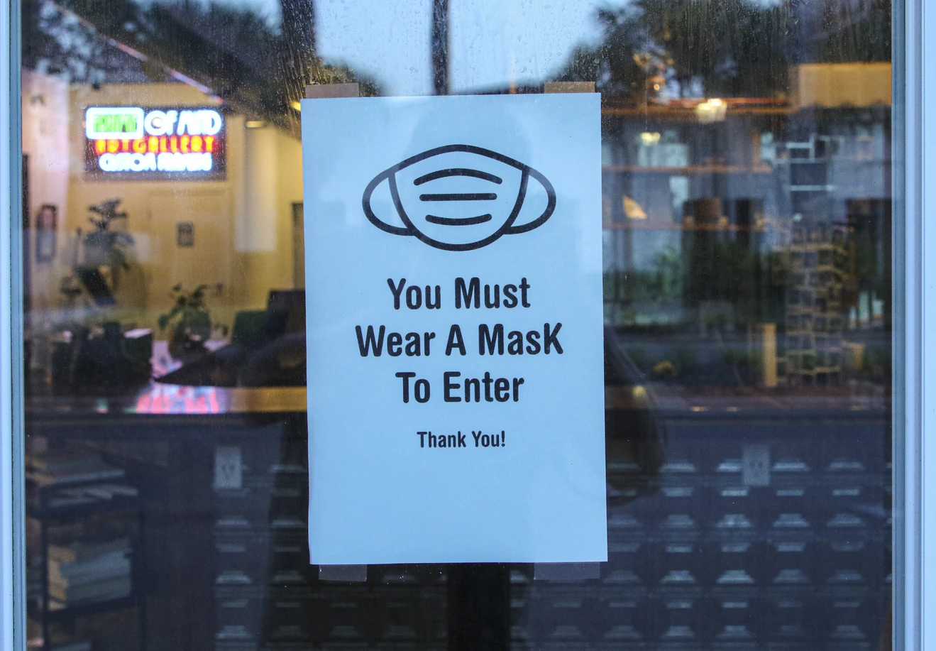
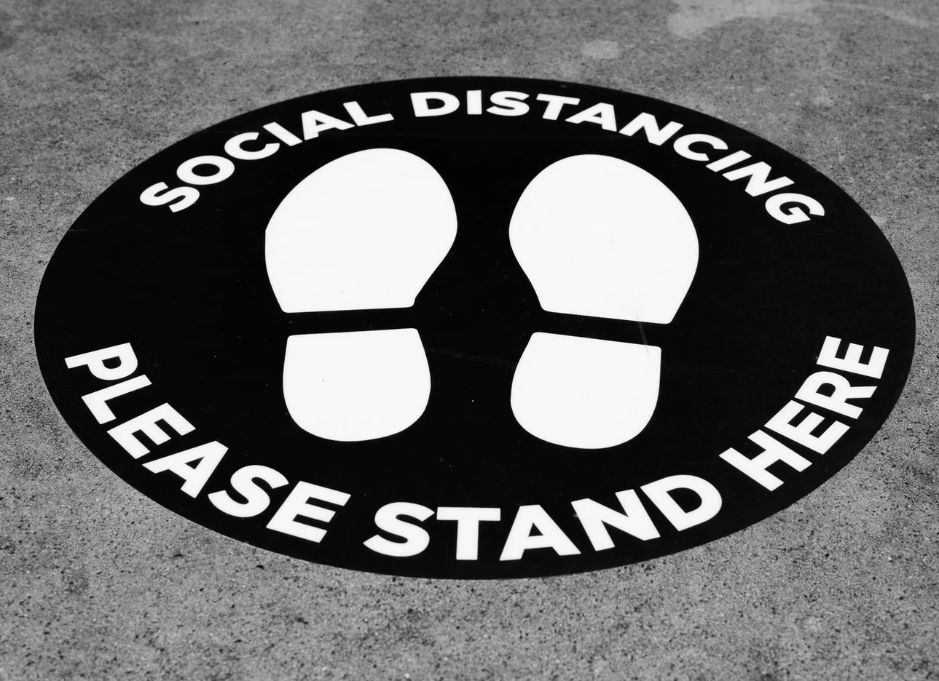
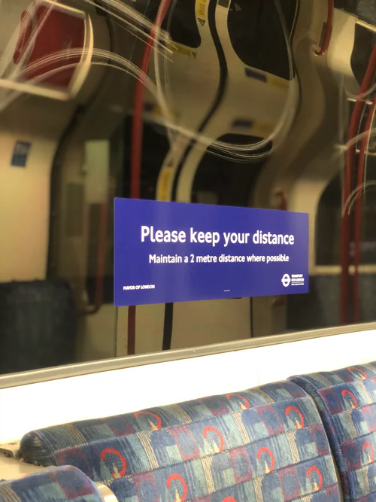
Notes:
https://unsplash.com/t/covid-19

Slide 40
Resource Sheet 1
https://wearerestless.org/2020/03/20/what-the-covid-19-response-can-teach-us-about-fighting-climate-change/
What the COVID-19 response can teach us about fighting climate change.
If we want to win the fight against climate change, we need start treat it as same as we handle COVID19, says Saffran Mihnar.
Humanity is facing a public health crisis. Today, we have come together, leaving aside issues of ego and pride, to tackle COVID19. To date, it has infected 210,000 people around the world but it will be affecting many more, as cities and countries go into lockdown for days and weeks. Our health systems are tested, our first responders and our medical workers sacrifice their sleep and other essential necessities to serve and help people overcome the challenge we are facing. Firstly I want to remind people to wash their hands, maintain social distance and follow all the advice recommended by the World Health Organisation. Let us all stay strong together, show solidarity and care for everyone who is affected by the current crisis.
As seriously as we must take coronavirus we must not forget that climate change is happening too. We really need to treat the environmental crisis with the same seriousness as we are fighting the new coronavirus. If we don’t take strong action and raise our ambition towards tackling the global climate crisis we will face an even greater health crisis, in the near future. We will have to face unprecedented natural disasters, changing weather patterns and rising sea levels. As a result, cities and countries will be sinking, food production will be impacted and the cost to the human population will continue to rise.
We can be the greatest superpower or developed country, but there is clear evidence that no matter how rich our economy is today, the humanitarian health crisis that we are going through will affect everyone. The climate crisis is having the same global impact. We are guided by the science and research in finding a vaccine for and fighting to contain COVID19 and clinical trials of investigational vaccines have been commenced in research laboratories. Let us also unite behind science and use available vaccines, known as nationally determined contributions to the Paris Agreement, in the fight against climate change.
The IPCC Special Report on Climate Change and Land, concludes that the dryland population, vulnerable to water stress, drought intensity and habitat degradation, could reach 178 million people by 2050. To avert such a scenario, the report calls for “prompt action” on climate mitigation. It estimates that the costs of upfront investments in sustainable land management (SLM) practices and technologies could range from as little as 20 to 500 dollars per hectare.
In recent weeks, you may have seen there has been a drastic drop in carbon emissions due to lockdowns and strong travel restrictions enforced by governments and also that ecosystems around the world are recovering. The air quality has increased in highly industrial countries as the biggest polluters, airlines and factories lay dormant. Nature is healing itself from all our inhumane actions against the planet. The planet is demonstrating its capacity to recover, if we give it a break. The planet provides for our food, shelter and basic needs, if we continue to damage it we will reach an irreversible point, where we will not be able to go back to normal life.
Notes:
https://wearerestless.org/2020/03/20/what-the-covid-19-response-can-teach-us-about-fighting-climate-change/

Slide 41
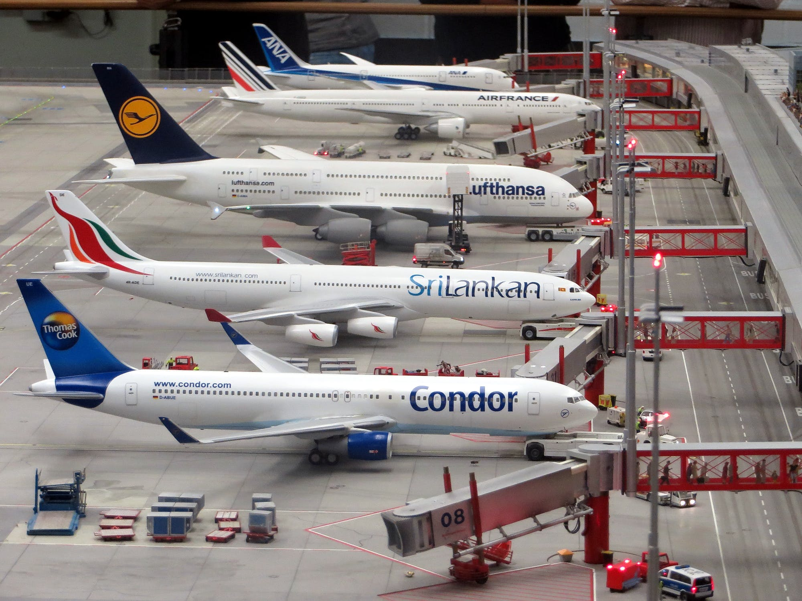
The SDGs and Climate Change
Coronavirus: How the travel downturn is sending jet planes to 'boneyards'
Hit by the collapse in demand for flights due to Covid-19 commercial airlines have parked their grounded fleet in some of the most remote locations in the world.
Aviation experts say the pandemic has forced more planes to these "boneyards" than any development in recent history. Long haul airplanes are also being prematurely retired. Last week British Airways, the world's largest operator of the jumbo jets, announced it would retire all of its 31 Boeing 747s, 10% of its total fleet, ahead of a planned phasing out in 2024.
In April, more than 14,000 passenger aircraft - equivalent to two-thirds of the global fleet - were grounded around the world, up from less than 1,900 planes at the beginning of the year, according to Cirium, a London-based aviation data and analytics company.
Some 7.5 million flights have been cancelled between January and July and the airline industry has already suffered up to $84bn of revenue losses this year, according to the International Air Transport Association (IATA)
"This is the largest grounding of commercial aircraft ever, precipitated by the virtual shutdown of the global passenger network as a consequence of travel restrictions resulting from the pandemic and the reduction in demand for passenger air travel," Rob Morris, head of consultancy at Cirium, told me in an email.
Notes:
https://www.pexels.com/photo/condor-airplane-on-grey-concrete-airport-163792/

Slide 42
Climate change: The rich are to blame, international study finds
It found that in transport the richest tenth of consumers use more than half the energy. This reflects previous research showing that 15% of UK travellers take 70% of all flights.
The ultra-rich fly by far furthest, while 57% of the UK population does not fly abroad at all.
The rich are primarily to blame for the global climate crisis, a study by the University of Leeds of 86 countries claims.
The wealthiest tenth of people consume about 20 times more energy overall than the bottom ten, wherever they live.
The gulf is greatest in transport, where the top tenth gobble 187 times more fuel than the poorest tenth, the research says.
That’s because people on the lowest incomes can rarely afford to drive.
The researchers found that the richer people became, the more energy they typically use. And it was replicated across all countries.
And they warn that, unless there's a significant policy change, household energy consumption could double from 2011 levels by 2050. That's even if energy efficiency improves
Rich Brits
The research also examined the relative energy consumption of one nation against another.
It shows that a fifth of UK citizens are in the top 5% of global energy consumers, along with 40% of German citizens, and Luxembourg’s entire population.
Only 2% of Chinese people are in the top global 5% of users, and just 0.02% of people in India.
Even the poorest fifth of Britons consumes over five times as much energy per person as the bottom billion in India.
Notes:
https://www.bbc.co.uk/news/business-51906530

