Slide 1
// MIGRATION //
Teaching Learning Unit
Supporting child migrants after the global pandemic
LESSON
TO WHICH GCE LEARNING OBJECTIVE DOES THIS PHASE CONTRIBUTE?
Key Stage 3 PSHE/Citizenship/ SMSC
Students will be able to:
Reflect on the journeys endured by child refugees in search of safety
Evaluate the misinformation presented in the media on the topic of Migrants and refugees
Understand the impact of Covid 19 on child refugees
Reflect on the need for understanding and compassion when dealing with refugees.
FROM THE SAT
5
DURATION
Big Idea Eight
Migration raises questions about how we see ‘ourselves’ and ‘the other’.
Migrants often face prejudice and discrimination
How I Act
I question and challenge assumptions and stereotypes (my own and others) about asylum seekers and migrants
I think about and change the way I live so that people are not negatively affected by my choices
I participate in campaigns on migration
I actively try to inspire and engage others to learn about and take action on migration
I am developing my global skills by:
I try to see things from different viewpoints and I respect other peoples ideas
I think about how we can all make a better future and what I can do to help.
1h
WHAT TEACHER DOES
Introduce lesson theme, the big ideas and learning outcomes
ACTIVITY 1 Think – Pair- Share – 5 minutes
Show information on slide 9 as stimulus
Should all countries in the world share the responsibility for refugees?
Activity Two- Teacher shares information with pupils from slides 10 to 32, pick out those images or bits of information that will work for your pupils. Use these to develop class discussions and lead up to the last activity.
Clips also included on slide 13
Activity Three – We Stand with you slide 31 TASK How will you show welcome?
1] Design a slogan for the stand or a piece of welcoming art work 0r 2] Write a letter to a child refugee showing welcome and compassion. Show that you have an :Understanding of the difficult journey they have faced /Understanding why they have left their home and family
Include three bits of positive advice that will help them settle in to the UK and have a great future.
LEARNING OUTCOME
TO WHICH SUBJECT IT IS CONNECTED?
Humanities – R.E., Geography, History, English.

Slide 2
// MIGRATION //
Teaching Learning Unit
How will the global pandemic impact on refugees?
https://www.theguardian.com/uk-news/2020/jun/29/covid-19-worsening-plight-of-uk-migrants-report-finds

Slide 3
// MIGRATION //
Teaching Learning Unit
DIAGRAM
The Big Ideas
Big Idea Eight
Migration raises questions about how we see ‘ourselves’ and ‘the other’.
Migrants often face prejudice and discrimination
How I Act
I question and challenge assumptions and stereotypes (my own and others) about asylum seekers and migrants
I think about and change the way I live so that people are not negatively affected by my choices
I participate in campaigns on migration
I actively try to inspire and engage others to learn about and take action on migration
I am developing my global skills by:
I try to see things from different viewpoints and I respect other peoples ideas
I think about how we can all make a better future and what I can do to help.

Slide 4
// Migration // Teaching Learning Unit Responding to the Global Pandemic
Lesson 5 Supporting Child Migrants ’
Lesson Title
Supporting child migrants after the global pandemic

Slide 5
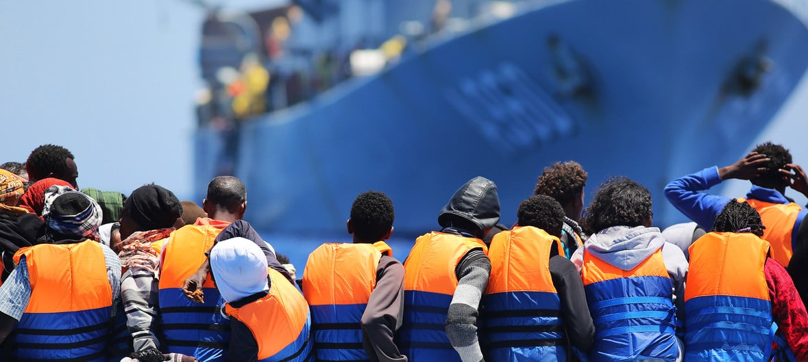
// MIGRATION //
Teaching Learning Unit
Thousands suffer extreme rights abuses journeying to Africa’s Mediterranean coast, say humanitarians
29 July 2020Migrants and Refugees
Thousands of refugees and migrants in eastern and western Africa, are dying while others face harrowing abuse in their attempts to reach the continent’s Mediterranean coast in search of a better life, UN/Danish Refugee Council report
Notes:
https://unric.org/el/29-7-2020-%CF%87%CE%B9%CE%BB%CE%B9%CE%AC%CE%B4%CE%B5%CF%82-%CF%85%CF%86%CE%AF%CF%83%CF%84%CE%B1%CE%BD%CF%84%CE%B1%CE%B9-%CF%80%CE%B1%CF%81%CE%B1%CE%B2%CE%B9%CE%AC%CF%83%CE%B5%CE%B9%CF%82-%CE%B1/

Slide 6
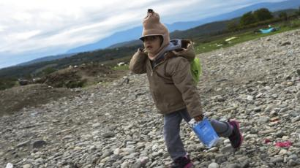
// Migration // Teaching Learning Unit Responding to the Global Pandemic
Lesson 5 Supporting Child Migrants ’
Lesson Objectives
Students will be able to:
Reflect on the journeys endured by child refugees in search of safety
Evaluate the misinformation presented in the media on the topic of Migrants and refugees
Understand the impact of Covid 19 on child refugees
Reflect on the need for understanding and compassion when dealing with refugees.
The UN definition of refugees is - people who are outside their country of origin for reasons of feared persecution, conflict, generalised violence, or other circumstances that have seriously disturbed public order and, as a result, require international protection.

Slide 7
// Migration // Teaching Learning Unit Responding to the Global Pandemic
Lesson 5 Supporting Child Migrants ’
Think- Pair- Share
The numbers of refugees attempting to find safety in the UK represents a tiny minority of global refugee numbers. Around 4,000 have attempted the journey this year. This may seem like a large number. Yet, it is hard to suggest that this figure is too large for the UK to accept when we expect far less affluent and secure states in the Global South to host far greater numbers:
85 per cent of the world’s refugees are currently hosted in developing states,
Lebanon, for example, a country approximately the size of Wales, with a GDP 50 times smaller than the UK, hosts nearly one million refugees.
The UK is the sixth largest economy in the world, and has the capacity and resources to be able to offer hope, security and opportunities for refugees to rebuild their lives at little cost
Should all countries in the world share the responsibility for refugees?

Slide 8
// Migration // Teaching Learning Unit Responding to the Global Pandemic
Lesson 5 Supporting Child Migrants ’
A child refugees journey They make these journeys in the hope of finding safety in Europe.
Home
Journey in search of safety
Numbers on the move
Dangers on the way
Numbers of unaccompanied children
coming to the UK
450 children were in the care of Kent council in April 2020
Recent arrivals have come from Syria, Afghanistan, Yemen, Eritrea, Chad, Egypt, Sudan, Nigeria, Somalia and Iraq.
They leave because of conflict, despair , poverty violence and human rights violations.
They usually need protection and safety
The number of asylum seekers arriving and applying to stay in other European nations is far, far higher than in the UK. Last year, some 165,600 sought asylum in Germany, 129,000 in France and 118,000 in Spain.
49,000 asylum applications made to stay in the UK
Gangs often prey on children and charge large sums of money to bring them to the UK on dangerous journeys in unfit boats .
Notes:
Danger every step of the way: A harrowing journey to Europe for refugee and migrant children
https://www.unicef.org.uk/publications/danger-every-step-of-the-way-a-harrowing-journey-to-europe-for-refugee-and-migrant-children/
https://www.concern.org.uk/news/something-inside-me-made-me-want-care-him-mother-tale-two-people-brought-together-adversity?gclid=CjwKCAjwkJj6BRA-EiwA0ZVPVstQsdHf6vRQE0luatEEB-5hpZUr6o2v1dKbWLof-KhbH6mT5x8yWxoCswsQAvD_BwE

Slide 9
// Migration // Teaching Learning Unit Responding to the Global Pandemic
Lesson 5 Supporting Child Migrants ’
A child refugees journey They make these journeys in the hope of finding safety in Europe.
Numbers on the move
1%
The UK is home to approx. 1% of the 29.6 million refugees, forcibly displaced across the world. The Refugee Council
The Children's Society
There are an estimated 13 million child refugees in the world
The total number of refugees worldwide who have been forced to flee war and persecution is more than 25 million, and more than half of them are children.
There are at least 1.8 million refugees in Europe
When it comes to refugees in Europe statistics, there is some disagreement over the total number of refugees currently in the continent, but we do know that 1.8 million refugees have arrived since 2014. That means it’s likely that there are currently around a million refugee children in Europe – and it’s possible that figure is larger.
Around 40,000 refugees arrive in the UK each year
The UK accepts relatively few refugees each year – just 1.6% of the total refugee numbers currently in Europe.
Currently the UK is home to 121,837 refugees
Notes:
https://www.refugeecouncil.org.uk/information/refugee-asylum-facts/the-truth-about-asylum/?gclid=CjwKCAjwkJj6BRA-EiwA0ZVPVgdwoWg9ElDpvqfWxYZ41FW7GK_ODKGXLyqU5Voehnr39ZQ9wDirwxoCA88QAvD_BwE
Danger every step of the way: A harrowing journey to Europe for refugee and migrant children
https://www.unicef.org.uk/publications/danger-every-step-of-the-way-a-harrowing-journey-to-europe-for-refugee-and-migrant-children/
https://www.concern.org.uk/news/something-inside-me-made-me-want-care-him-mother-tale-two-people-brought-together-adversity?gclid=CjwKCAjwkJj6BRA-EiwA0ZVPVstQsdHf6vRQE0luatEEB-5hpZUr6o2v1dKbWLof-KhbH6mT5x8yWxoCswsQAvD_BwE

Slide 10
// Migration // Teaching Learning Unit Responding to the Global Pandemic
Lesson 5 Supporting Child Migrants ’
A child refugees journey They make these journeys in the hope of finding safety in Europe.
Why is the UK a popular destination?
The Reality
Children who arrive without an adult, meanwhile, tend to be taken into the care of Kent County Council, and allocated a foster home or care home.
Those who have claimed asylum are given £37.75 per week to live on until they receive their decision.
Asylum seekers may have other family members in the UK.
They may speak English.
We have a reputation as a fair and democratic society that respects peoples human rights

Slide 11
// Migration // Teaching Learning Unit Responding to the Global Pandemic
Lesson 5 Supporting Child Migrants ’
A child refugees journey They make these journeys in the hope of finding safety in Europe.
A Refugee’s Journey
A young refugee's journey doesn't stop when they arrive in the UK
https://vimeo.com/342238544
https://www.childrenssociety.org.uk/what-we-do/our-work/refugee-and-migrant-children

Slide 12
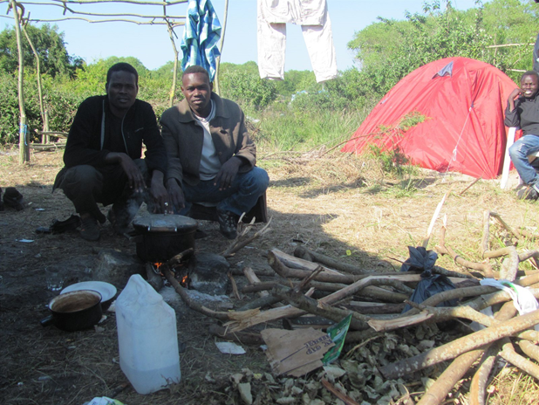
// Migration // Teaching Learning Unit Responding to the Global Pandemic
Lesson 5 Supporting Child Migrants ’
.
What is happening in Calais?

Slide 13
// Migration // Teaching Learning Unit Responding to the Global Pandemic
Lesson 5 Supporting Child Migrants ’
Calais is a port city in the north of France, right across from Dover in the south of England. It is where the ‘Refugee Jungle’ used to be until it was torn down by French authorities in 2016. However, there are still a constant of about 1,500 displaced people living there, trying to get to the UK to seek asylum.
Many refugees try the sea crossing in small and dangerous dinghies risking their lives to the sea.
In August 2020 a young migrant died making the crossing in a small dingy,
‘Sudanese migrant, 16, drowned in Channel after shovel he was using as an oar PUNCTURED his blow-up boat, reveals survivor’ Daily Mail newspaper heading
https://www.conversationsfromcalais.com/
Notes:
https://www.conversationsfromcalais.com/

Slide 14
// Migration // Teaching Learning Unit Responding to the Global Pandemic
Lesson 5 Supporting Child Migrants ’
Charities that support refugees- Care4Calais?
lare Moseley, founder of migrant charity Care4Calais, said the young man 'did not deserve to die alone at sea'.
'We are absolutely devastated by the unnecessary death,' she said. 'We can only imagine the fear he felt and our hearts go out to his family. This death starkly demonstrates the total failure of our government to do anything to help those who are in such desperate straits.
'We need a way for people's asylum claims to be fairly heard without them having to risk their lives. We need this before someone else dies.'
Notes:
https://www.conversationsfromcalais.com/

Slide 15
// Migration // Teaching Learning Unit Responding to the Global Pandemic
Lesson 5 Supporting Child Migrants ’
Resource 1
Behind the Channel crossings: migrant stories of life or death in tiny inflatables The Guardian
Two refugees’ efforts to reach Dover reflect persecution in Sudan and rising tensions over migrants in Europe
From The Guardian :
On the night he attempted to cross the Channel, Abdulfatah Hamdallah left his blanket and bicycle behind at the camp in Calais.
They were the only possessions he would leave behind: his backpack was lost at sea when he drowned attempting to make the perilous crossing over the Dover Strait to England in a dinghy, with shovels for oars.
His body was found at Sangatte beach in France. He was not the first asylum seeker to make the journey and he will not be the last. But he died as tensions mount over the increasing numbers of small-boat crossings in the Channel and amid a war of words between Britain and France.
So far this year more than 4,900 people have arrived to enter the UK via small boats, dwarfing the total for 2019.
Hamdallah’s death underlines the risks migrants are willing to take to find a better life. He is understood to have left his village in West Kordofan, Sudan, near the Darfur border, in 2015.
His brother, Al-Fatih Hamdallah, told the Guardian that life was so “tough” in Sudan they had had no choice but to leave. He first travelled from his home near En Nahud across the Sahara with the help of smugglers to Tripoli, Libya, to join his brothers. While in Libya they worked at a car wash. They were in Tripoli for two years when Abdulfatah left without telling his brother where he was going.
His cousin, Al-Noor Mohammed, 16, who is in Calais, said Abdulfatah made the journey from Libya three years ago from the coastal city of Zuwara with the aid of people smugglers. He got to Italy but did not stay for long, and set off for France on foot.
Notes:
https://www.conversationsfromcalais.com/

Slide 16
// Migration // Teaching Learning Unit Responding to the Global Pandemic
Lesson 5 Supporting Child Migrants ’
Resource 1
Article continued
Mohammed regularly saw his cousin in the Calais camp. “We are all staying and sleeping together in the same area, he was a sociable person and had a lot of friends,” he said.
His brother, who remains in Libya, said that Abdulfatah was ambitious and wanted to have a better life. “He wanted to build his future, so he couldn’t stay in Sudan,” he said.
After Abdulfatah had his request for asylum in France turned down he decided to cross the Channel to the UK. He acquired a dinghy, similar to a pool inflatable in size and quality, and two shovels for oars. He and a friend failed in their attempt, and were thrown into the water. The friend survived and was taken to hospital but Abdulfatah, who could not swim, drowned.
Thousands of Sudanese nationals have applied for asylum in the UK in the last five years, with as many as 2,900 in 2015 alone.The conflict in Darfur, western Sudan, erupted in 2003 when the government armed Arab militias to suppress an insurgency by non-Arab rebel groups complaining about political and economic marginalisation.
The government responded by carrying out genocide of the region’s non-Arab population, causing the deaths of hundreds of thousands of civilians.
The country’s former president, Omar al-Bashir, was indicted by the international criminal court for genocide, war crimes, and crimes against humanity.There has been a deepening economic crisis in recent years, and humanitarian groups say excessive use of force and unlawful killings by Sudanese security forces against peaceful protesters continue.
Bashir was removed as president in April 2019 and a civilian-led transitional government is now in place. Sudan is in a period of transition towards elections in 2022.
The security situation in Darfur, however, remains volatile and unstable. Banditry and lawlessness are widespread, and there are frequent violent attacks against civilians by militias, which have led to the killing of many and displacement of thousands. Another Sudanese asylum seeker is understood to have died in the Mediterranean on Thursday.
Notes:
https://www.conversationsfromcalais.com/

Slide 17
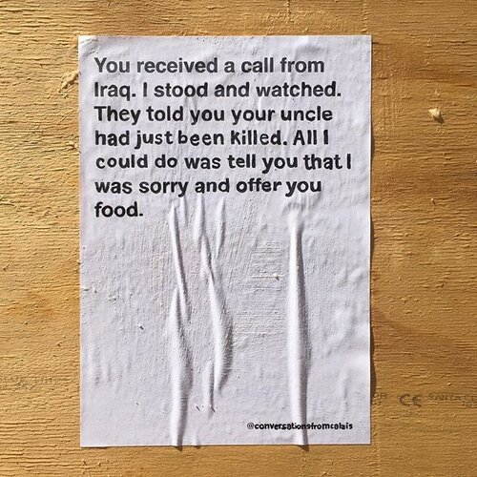
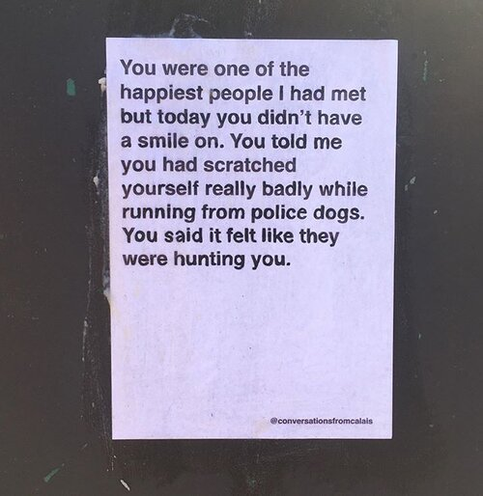
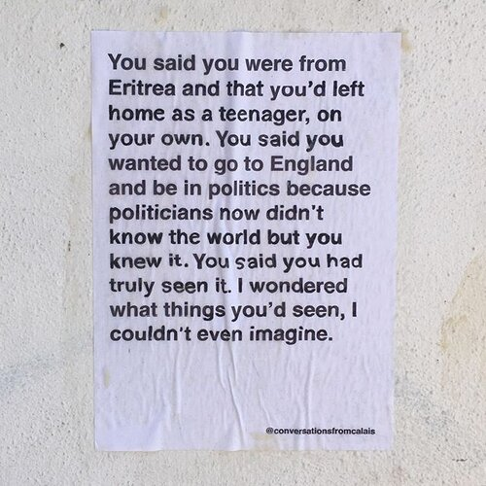
// Migration // Teaching Learning Unit Responding to the Global Pandemic
Lesson 5 Supporting Child Migrants ’
Conversations from Calais
Documenting conversations between volunteers and migrants met in Calais.
Sharing them with the world by pasting them on our cities’ walls.
Re-humanising the refugee crisis. https://www.conversationsfromcalais.com/
Notes:
https://www.conversationsfromcalais.com/

Slide 18
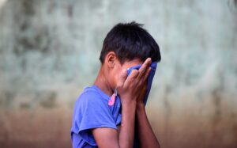
// MIGRATION //
Teaching Learning Unit
Lone Child Refugees Exploring journeys in a post Covid world
Lone child refugees arriving in the UK are cut off not only from the culture, language, homeland and familiar circumstances in which they grew up but also from the love and concern of the people who have cared for them most. Their parents may have died, been detained or otherwise unable to leave. Many separated children will have suffered the trauma of war, civil unrest, bereavement, hunger and persecution, and the stresses of long and hazardous journeys.
A refugee is someone who survived and who can create the future.Amela Koluder
“I was only 8 years old when I lost my entire family. Only I and my younger brother survived….”
Kamran Foladi, from Afghanistan
“No one puts their children in a boat unless the water is safer than the land.”
Warsan Shire
Notes:
https://separatedchild.org/our-work/refugee-quotes/?gclid=CjwKCAjwkJj6BRA-EiwA0ZVPVss9_twuuyuPD6HIGW6gqTI9PKMoEghCKMcyDWFFYjv9NsIVedxqPxoCZBYQAvD_BwE

Slide 19
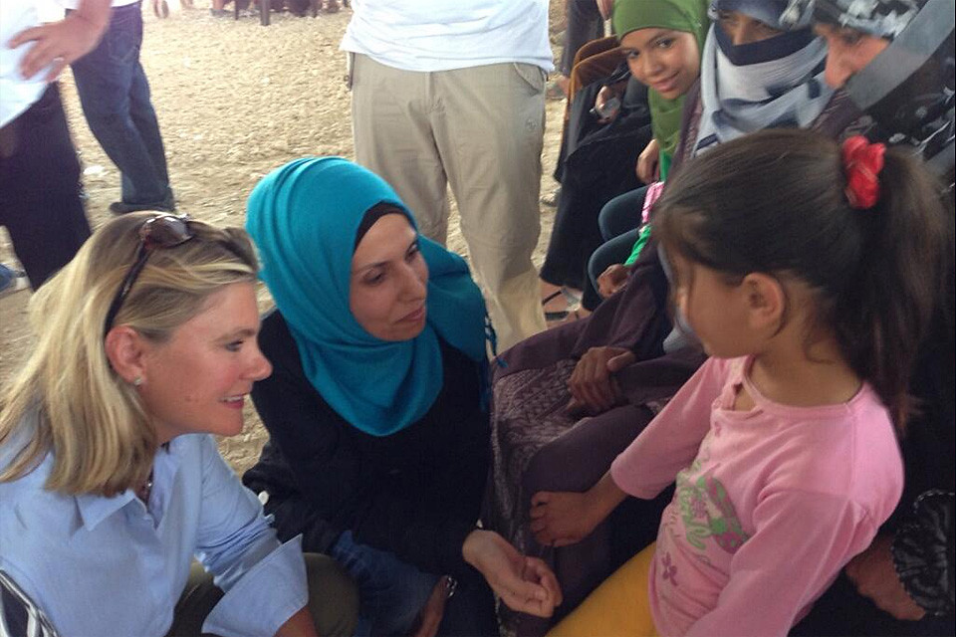
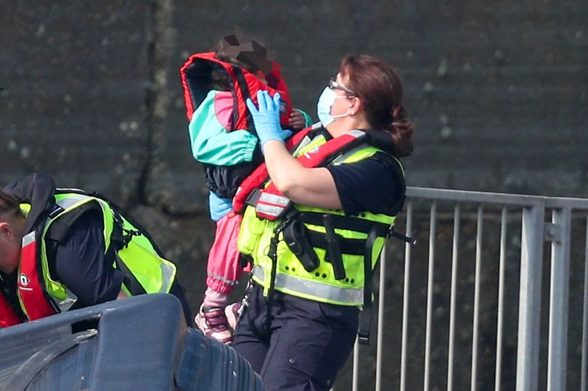
// MIGRATION //
Teaching Learning Unit
A Border Force officer holds a child rescued from a boat crossing the Channel

Slide 20
// MIGRATION //
Teaching Learning Unit
Newspaper headlines
https://www.kentlive.news/news/kent-news/protest-support-refugees-set-take-4456530
Bridget Chapman, spokeswoman for Kent Refugee Action Network, said:
“Everyone on those boats is a human being who deserves a chance to have safe and legal passage to make their claim. That would stop these crossings overnight and would mean we knew exactly who was arriving and when.”

Slide 21
// MIGRATION //
Teaching Learning Unit
Influencing opinion
Recognising the difference between refugees seeking asylum and economic migrants in search of work
What should we do?
Many newspapers in the UK use emotive words and headlines to make people in the UK worry about this issue when in reality the number coming here is very small.
Words are used by the media that create fear and worry –
Swarm, battle, swamped, under siege
These make people concerned when the number of refugees coming to the UK is very small in comparison with other countries.

Slide 22
// MIGRATION //
Teaching Learning Unit
Newspaper headlines
The Guardian July 2020
Five migrant children rescued in Channel as number of UK arrivals soars
On World Refugee Day, a look at how COVID-19 is affecting refugees and asylum seekers
Nearly half of British public have little or no sympathy for migrants crossing Channel from France, survey finds The Independent
News Item -Publication date: 27 May 2020
COVID-19 puts asylum seekers at a higher risk as conditions in camps deteriorate and asylum procedures are suspended
Refugees crossing Channel tell of beatings by French police
Asylum seekers give accounts of injuries, as Priti Patel says many refugees feel France is racist The Guardian
Protest in support of refugees set to take place in Dover
The event, which is called ‘We Stand With You’ will be attended by campaigners and politician
Why are migrants crossing the English Channel?
BBC News

Slide 23
// MIGRATION //
Teaching Learning Unit
Newspaper headlines
A third YouGov survey suggested 46 per cent of Britons believe that in comparison with other EU countries, the UK has “done more than our fair share to accommodate refugees”.
However, European Union data shows that, in 2019, Germany received 165,600 asylum applications – the largest of any EU country, followed by France with 128,900, Spain with 117,800, Greece with 77,300, and the UK with 44,800.
Notes:
https://www.independent.co.uk/news/uk/home-news/migrant-channel-crossing-yougov-uk-france-asylum-refugee-a9666041.html

Slide 24
// MIGRATION //
Teaching Learning Unit
How will Covid 19 Impact on Refugees?
Notes:
https://www.independent.co.uk/news/uk/home-news/migrant-channel-crossing-yougov-uk-france-asylum-refugee-a9666041.html

Slide 25
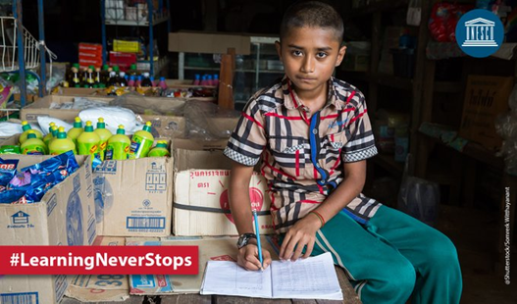
// MIGRATION //
Teaching Learning Unit
Even before COVID-19, refugee children were twice as unlikely as other children to attend school”, said Audrey Azoulay, Director-General of the UN’s educational and cultural agency, UNESCO,
“Four million of these children, aged between five and 17, did not attend primary or secondary education, and only one per cent embarked on higher education, severely limiting their chances for the future.”
One billion out of school
Although some countries are slowly emerging from the pandemic, with an increasing trend towards re-opening schools, more than one billion students worldwide are still out of the classroom, according to UN estimates.
COVID-19 has upended lives and societies but its impacts have been harshest for the world’s most vulnerable people, such as the nearly 80 million refugees who have been forced to flee their homelands.
Despite improved enrollment rates, only 63 per cent of refugee children are receiving primary or secondary education.
UNHCR Special Envoy Angelina Jolie underscored why the disruption to education cannot become permanent.
“COVID-19 is proving to be an incredible catalyst for science, and discovery and innovation”, she stated.
“And if we could do the same for education—harnessing new technologies with the power of government and private sector funding, and the energy and the drive of millions of talented young people—it would be one of the greatest single inoculations imaginable against poverty and the denial of rights worldwide.”

Slide 26
// MIGRATION //
Teaching Learning Unit
Migrant and displaced children in the age of COVID-19: How the pandemic is impacting them and what can we do to help
Indirect impacts – including enormous socioeconomic challenges – are potentially catastrophic for children. Weakened health systems and disrupted health services, job and income losses, interrupted access to school, and travel and movement restrictions bear directly on the well-being of children and young people. Those whose lives are already marked by insecurity will be affected even more seriously.
Migrant and displaced children are among the most vulnerable populations on the globe.
In 2019, around 33 million children were living outside of their country of birth, including many who were forcibly displaced across borders. At the end of 2018, a total of over 31 million children were living in forced displacement in their own country or abroad due to violence and conflict. This includes some 13 million child refugees, around 1 million asylum-seeking children, and an estimated 17 million children displaced within their own countries. It is estimated that 3.7 million children live in refugee camps or collective centres.2 COVID-19 threatens to bring even more uncertainty and harm to their lives.

Slide 27
// MIGRATION //
Teaching Learning Unit
Migrant and displaced children in the age of COVID-19: How the pandemic is impacting them and what can we do to help
Many migrants and displaced children live in conditions where latrines and water supplies are inadequate and extreme overcrowding is common. Humanitarian agencies have warned of the catastrophic health consequences of COVID-19 for displaced persons around the world – especially children.
Migrant and displaced children often live in families
that are more vulnerable to job loss or economic
downturns. The World Bank has suggested that
COVID-19 will push some 40 to 60 million people
into extreme poverty, forecasting stark economic
consequences.
Many foreign nationals are employed in short-term work in trades such as tourism, hospitality, construction, and the garment industry, and are at great risk of losing their jobs. Others are engaged in precarious work with limited provision for health care or sick leave

Slide 28
// MIGRATION //
Teaching Learning Unit
Conversations from Calais
There are many ways in which you can help:
1. Be kind - by treating everyone you meet with humanity and respect.
2. Be open - by raising awareness on what is happening in Calais, by sharing it on your social media and by never refusing to stop talking about it.
3. Be political - by demanding changes from your MP, by voting for people and parties that consider this issue in their policies, by protesting and by signing petitions.
4. Be active - by donating your time or money to the following organisations: Refugee Community Kitchen, Refugee Women’s Centre, Project Play, Calais Woodyard, Collective Aid, L’Auberge des Migrants, Utopia56 and Help Refugees.
5. Be generous - by supporting businesses employing or supporting refugees, such as: Migrateful, Imad’s Syrian Kitchen, Mo’s Eggs, Stories & Supper, nisa and Makers Unite.

Slide 29
// MIGRATION //
Teaching Learning Unit
Why KentLive uses the word 'people' when referring to 'migrants'
KentLive uses the term people when referring to those who cross the Channel and arrive on our shores.
That's because, regardless of their status at the point of entry, those moving from one country to the other are human beings.
You will have seen them commonly referred to as migrants. This is not incorrect.
The UN Migration Agency defines a migrant as - any person who is moving or has moved across an international border or within a state away from his/her habitual place of residence, regardless of the person’s legal status, whether the movement is voluntary or involuntary, what the causes for the movement are, or what the length of the stay is.
KentLive also refers to people in these circumstances as refugees.
The UN definition of refugees is - people who are outside their country of origin for reasons of feared persecution, conflict, generalised violence, or other circumstances that have seriously disturbed public order and, as a result, require international protection.

Slide 30
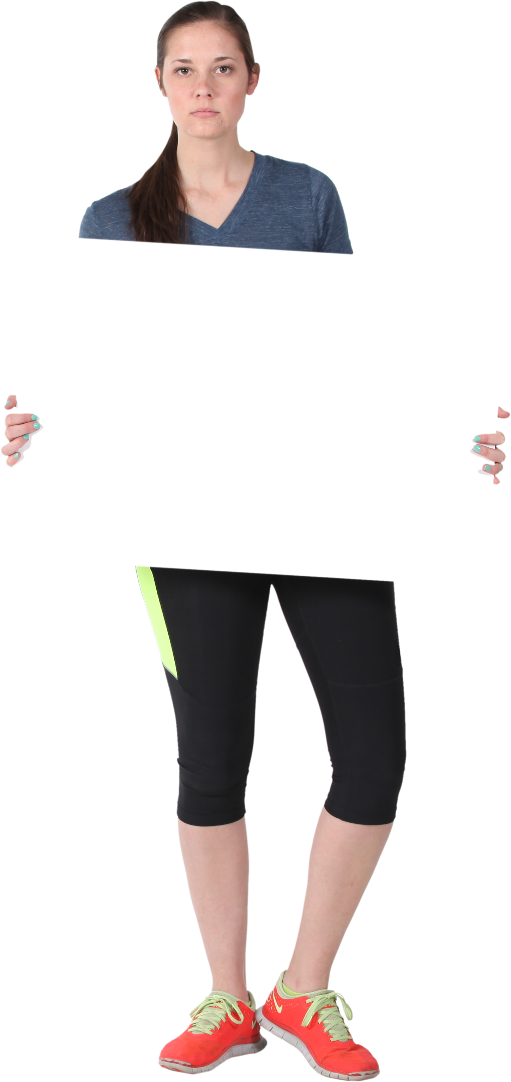
// MIGRATION //
Teaching Learning Unit
‘We Stand With You’
In Kent where they welcome many refugees who manage to make the dangerous journey they are planning to stand in solidarity with refugees and migrants who are seeking sanctuary from war, poverty, persecution or climate catastrophe. They will do this in Sept 2020 by hosting a solidarity stand.
TASK How will you show welcome?
1] Design a slogan for the stand or a piece of welcoming art work
0r
2] Write a letter to a child refugee showing welcome and compassion. Show that you have an :
Understanding of the difficult journey they have faced
Understanding why they have left their home and family
Include three bits of positive advice that will help them settle in to the UK and have a great future.

Slide 31
// MIGRATION //
Teaching Learning Unit
Additional Resources

Slide 32
Migrant and displaced children in the age of COVID-19: How the pandemic is impacting them and what can we do to help Policies and actions are needed to:
1. Include migrant and displaced children in preparedness, response, and mitigation efforts for COVID-19.
2. Provide accessible, timely, culturally and linguistically appropriate, child-friendly and relevant information on COVID-19 to children and families on the move.
3. Ensure access to clean water, basic toilets and good hygiene practices for migrant and displaced children and families when transiting or for those living in camps and in urban areas.
4. Ensure universal access to COVID-19 testing, health care, mental health and psychosocial support, and other essential services, for all those who need them, regardless of status.
5. Support and advocate for safer living and housing conditions to allow for social distancing, including in shelters and camps for refugees and internally displaced persons.
6. Implement education strategies for continued learning for all children – including migrant and displaced children – and make schools safe, healthy, and inclusive environments.
7. Stop refoulement, immigration, detention, push-backs, deportations and mass expulsions of migrant and displaced children and families in the context of the COVID-19 pandemic. These practices threaten children’s rights and are a risk to public health.
8. Expand social protection policies and programmes to minimize the economic impact of COVID-19 on families.
9. Advocate proactively against xenophobia, stigma and discrimination – the virus does not discriminate, and neither should we. Collaboration and unity are needed more than ever to ensure health, safety, and protection for all, especially for those in the most vulnerable of circumstances. Around the world, millions of migrant and displaced children on nearly every continent are already facing acute deprivations that will upend their growth and development as they mature into adults. COVID-19 presents even greater challenges and threatens to disrupt their lives even further. Protecting these children’s well-being today is the best way to invest in their future and restore hope for a calmer path ahead.
Notes:
Migrant and displaced children in the age of COVID-19: How the pandemic is impacting them and what can we do to help Danzhen You, Naomi Lindt, Rose Allen, Claus Hansen, Jan Beise and Saskia Blume1

Slide 33
// Migration // Teaching Learning Unit Responding to the Global Pandemic
Lesson 5 Supporting Child Migrants ’
And, despite the overinflated claims, the numbers of refugees attempting to find safety in the UK represent a tiny minority of global refugee numbers. Around 4,000 have attempted the journey this year. This may seem like a large number. Yet, it is hard to suggest that this figure is too large for the UK to accept when we expect far less affluent and secure states in the Global South to host far greater numbers: 85 per cent of the world’s refugees are currently hosted in developing states, and Lebanon, for example, a country approximately the size of Wales, with a GDP 50 times smaller than the UK, hosts nearly one million refugees.
. It is difficult, if not impossible, to morally justify turning innocent refugees away to suffer harm and human rights violations when we could easily help them.
The Independent
The simple truth is that these refugees are in urgent need of protection and are asking for our help. They have been forced to flee violence and human rights violations in their own country, and they view the UK as a place of sanctuary where they can rebuild their lives.

Slide 34
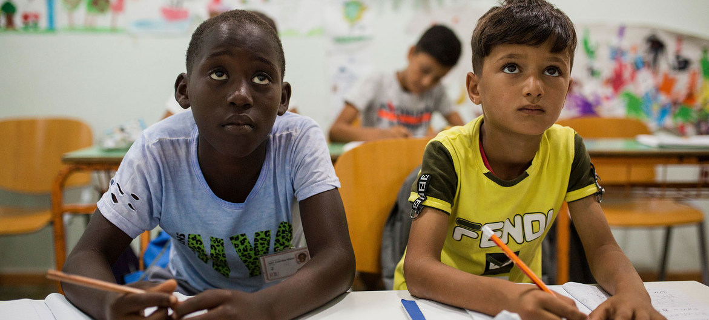
// MIGRATION //
Teaching Learning Unit
UNHCR/Socrates Baltagiannis
Two refugee boys in a classroom at a reception centre in Kos, Greece.

Slide 35
Emotive Language: Linguistic Depictions of the Three Year-Old Drowned Refugee Boy in the Greek Journalistic Discourse
https://interface.org.tw/index.php/if/article/view/52/308

